Slide 1

Polypharmacy in the elderly
Susan Buchkowsky, PharmD ER, Richmond Hospital
Arden Barry, PharmD Heart Health Clinics, Jim Pattison Outpatient Care and Surgery Centre

Slide 2
Disclosure
I have no current or past relationships with commercial entities

Slide 3
Learning Objectives
Define polypharmacy and identify at least one negative clinical outcome associated with polypharmacy.
Identify medications commonly associated with prescribing cascades.
Describe an approach to assessing polypharmacy and mitigating polypharmacy through deprescribing.
Recognize resources to assist with deprescribing.

Slide 4
What is Polypharmacy?
No standard definition
Often defined as routine use of five or more medications
Includes prescription and OTC medications, as well as natural health products and complementary medicines
WHO Medication Safety in Polypharmacy Technical Report 2019
Notes:
Polypharmacy is not solely about the number of medications used, but also about the effectiveness, utility, and potential harm of each medication, both individually or in combination.

Slide 5
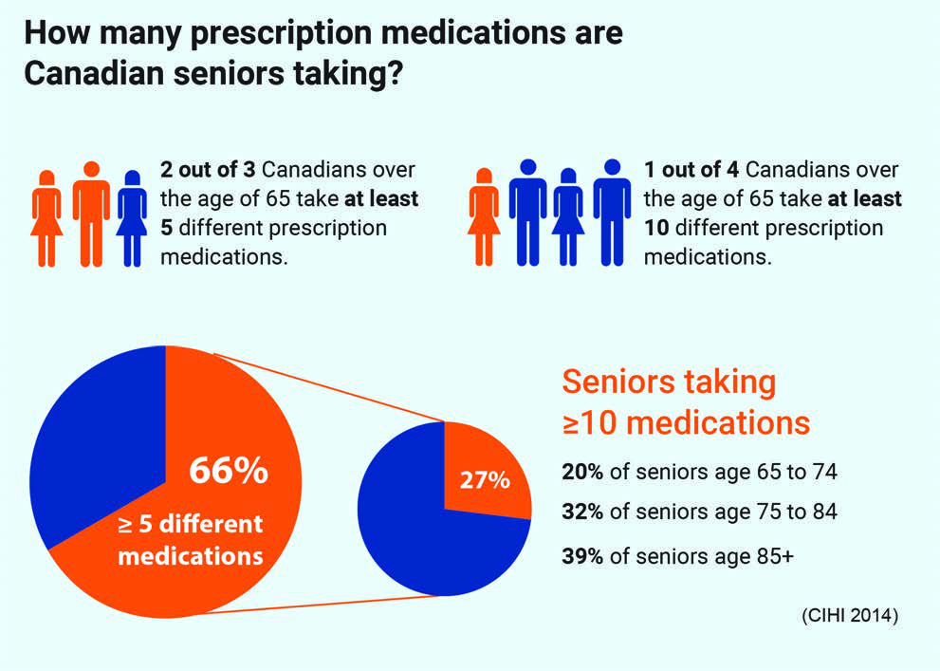
Polypharmacy
ISMP Canada Safety Bulletin Volume 18 Issue 3 March 28, 2018
Notes:
There is an 8-fold greater risk of drug–drug interactions as the number of medications prescribed increases from 2 to 10
The cost of potentially inappropriate medication use in Canada has been estimated at $419 million annually, and the cost of treating the harmful effects of these medications is estimated to be $1.4 billion every year

Slide 6
Polypharmacy
Meta-analysis in India
  49% polypharmacy
  31% of pts on > 10 medications
Multinational population-based study
  Range of 20.1 to 46.4% polypharmacy
  Australia, United Kingdom, South Korea, Taiwan and Hong Kong
Frontiers in Pharmacology 12 2021
Age and Ageing 52(2) 2023
Notes:
Polypharmacy is a global problem.

Slide 7
Risk factors for Polypharmacy in the Elderly
Multiple comorbidities
Multiple specialists
Frailty
Cognitive impairment
Lack of primary care provider
American Family Physician 2019;100:32-38.
Notes:
Edmonton Frail Scale

Slide 8
Risk for Adverse Outcomes in the Elderly
More sensitive to adverse effects due to physiological (PK/PD) changes
More drugs = more drug interactions
Cognitive changes
Nutritional status changes
Social supports
American Family Physician 2019;100:32-38.
Notes:
Edmonton Frail Scale

Slide 9
Polypharmacy
Both polypharmacy and excessive polypharmacy increase the risk of all-cause hospitalization after adjusting for age, sex, and time-varying comorbidities
Polypharmacy (use of ≥4 prescription medications daily) caused 1.5–2x higher possibility of recurrent falls in older adults
CMAJ 2015;187:E130-7;
Can Geriatr J 2018;21(1):14-25

Slide 10
Other Consequences of Polypharmacy
Increased adverse effects
Cognitive impairment
Decreased quality of life
Decreased adherence
Increased mortality
Increased health care costs and utilization
American Family Physician 2019;100:32-38.
Mayo Clin Proc 2021;96 (1):242-256.

Slide 11
Prescribing Cascade
A sequence of events in which an adverse drug event is misinterpreted as a new medical condition which leads to the addition of another medication
CMAJ 2021 193(6) e215

Slide 12
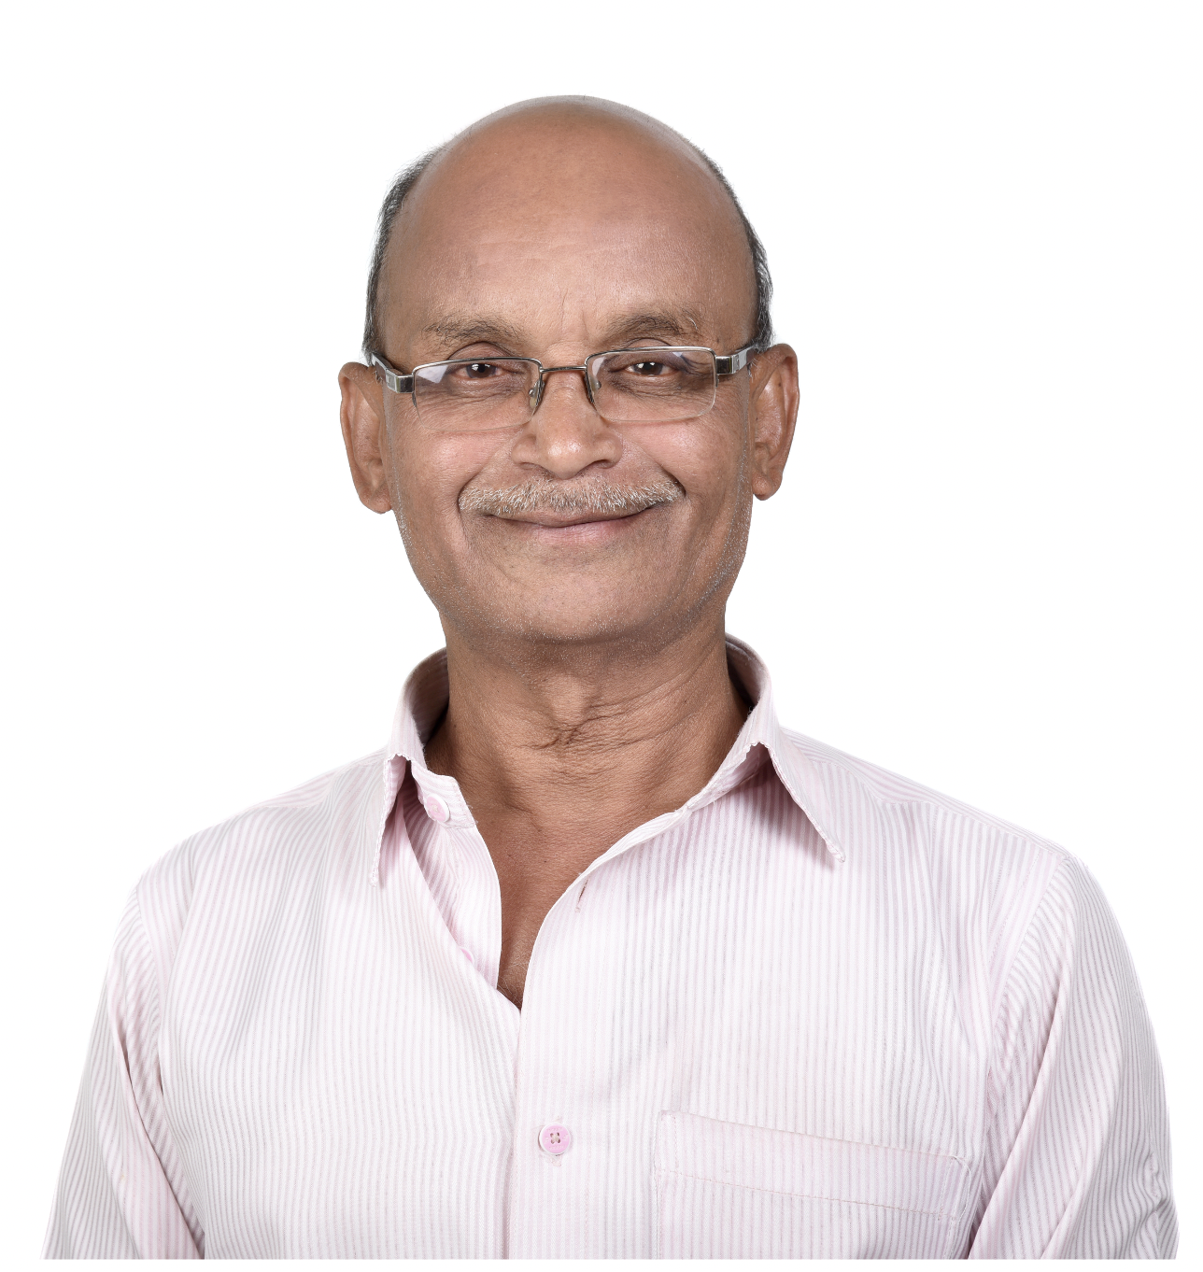
Prescribing Cascade Case Example
75-year-old South Asian male
PMHx: hypertension
Rx:
  Ramipril 5 mg PO daily
  Amlodipine 5 mg PO daily

Slide 13
Case Example
BP elevated
Increase amlodipine to 10 mg PO daily
Patient presents with peripheral edema
Start furosemide 40 mg PO daily
Start KCl 8 mEq PO BID
Notes:
Peripheral edema due to amlodipine

Slide 14
Case Example
Patient presents with GERD-like symptoms
Start rabeprazole 20 mg PO daily
Routine BW shows vitamin B12 deficiency
Start vitamin B12 1000 mcg PO daily
Notes:
GERD-like symptoms due to potassium
Vitamin B12 deficiency due to PPI

Slide 15
Case Example
Patient c/o frequent urination and urgency
Start oxybutynin 10 mg PO daily
Patient c/o constipation
Start docusate 100 mg PO BID
Start PEG-3350 17 g PO daily PRN
Start sennosides 24 mg PO daily PRN
Notes:
Frequent urination and urgency due to furosemide
Constipation due to oxybutynin

Slide 16
Case Example
Patient c/o confusion and insomnia
Start donepezil 5 mg PO daily
Start zopiclone 7.5 mg PO daily
Patient’s develops worsening cognitive impairment
Notes:
Confusion and insomnia die to oxybutynin
Cognitive impairment due to zopilcone

Slide 17
Case Example
Ramipril 5 mg PO daily
Amlodipine 10 mg PO daily
Furosemide 40 mg PO daily
KCl 8 mEq PO BID
Rabeprazole 20 mg PO daily
Vitamin B12 1000 mcg PO daily
Oxybutynin 10 mg PO daily
Docusate 100 mg PO BID
PEG-3350 17 g PO daily PRN
Sennosides 24 mg PO daily PRN
Donepezil 5 mg PO daily
Zopiclone 7.5 mg PO daily
Patient enters LTC
All medications eventually are discontinued
Patient stabilized on ramipril for hypertension

Slide 18
My Approach
Is the medication:
  Safe?
  Needed?
  Effective?
Other considerations (adherence, cost)
Start low, go slow
“Clean up” PRNs

Slide 19
My Approach
Start with medical problem list and BPMH
Match each medical problem with Rx
Identify Rx without indication
Prioritize Rx to deprescribe:
  Causing adverse effect
  No known indication
  Inappropriate (risks > benefits)
  Do not align with goals of care

Slide 20
My Approach
Simplify drug regimens
Be aware of prescribing cascades
Example drug interactions:
  Beta-blocker and diltiazem = heart block
  ACEI + NSAID + diuretic = AKI

Slide 21

My Approach
Look for red flags
Anticoagulants
Anticholinergics
Antihypertensives
Antipsychotics
Benzodiazepines
Digoxin
Glyburide
Metoclopramide
NSAIDs
Opioids
PPIs
J Am Geriatr Soc 2023;71:2052-2081
Age and Aging 2015;44:213-218
Notes:
2023 Updated Beers Criteria
Anticholinergic drugs: antihistamines, antiparkinsonian, skeletal muscle relaxants, antidepressants, antimuscarinics, antispasmodics, antiemetics

Slide 22
Deprescribing
“Assume every drug is not needed until proven otherwise.” - James McCormack
“We’ve mastered addition. Now it’s time to move on to subtraction.” - Loren Regier
“Starting medications is like the bliss of marriage and stopping them is like the agony of divorce.” - Doug Danforth

Slide 23
Deprescribing
The process of discontinuing or reducing the dose of medications in order to improve patient outcomes, reduce the risk of harm, reduce cost, and/or reduce complexity including pill burden
CMAJ 2021: 193(6) E215.

Slide 24
Reasons to consider Deprescribing
  Low probability of a positive outcome
  Lag in time-to-benefit
  Misalignment between the patient’s therapeutic goals and potential benefit of medication
  Nonadherence
  Improve quality of life
  Minimize risk of adverse effects
  Reduce cost to the patient or health care system

Slide 25
Deprescribing
Must be in partnership with patient
Shared decision-making using patient-driven goals that balance expected benefit vs possible harm
Always document reason for discontinuation
Notes:
Share example about the tick box approach to renewals at family practice offices, where medications are inadvertently restarted by being “checked” in the computer software

Slide 26
Deprescribing
Many toolkits and algorithms available
Formal deprescribing rounds on discharge
  More medications deprescribed
  Reduced rates of readmission to hospital and ER visits
Int J Clin Pharm 2019;41:159-66

Slide 27
Deprescribing.org
PPIs
Benzodiazepine receptor agonists
Antihyperglycemics
Antipsychotics
Cholinesterase inhibitors and memantine
Working statin deprescribing guideline

Slide 28

Canadian Deprescribing Network
www.deprescribingnetwork.ca
Notes:
Do I still need this medication? Is deprescribing for you? (deprescribingnetwork.ca)

Slide 29
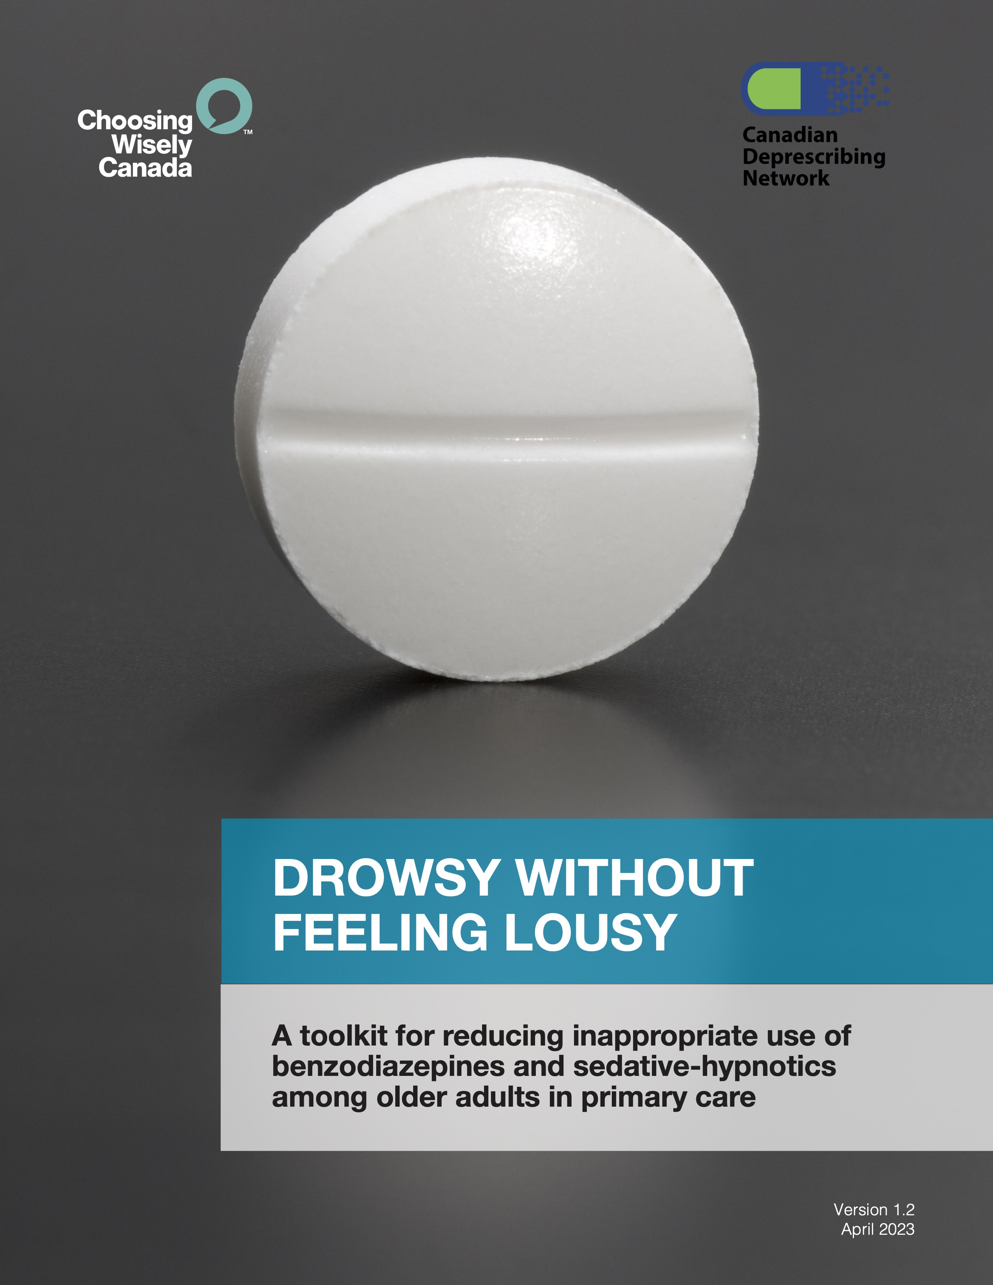
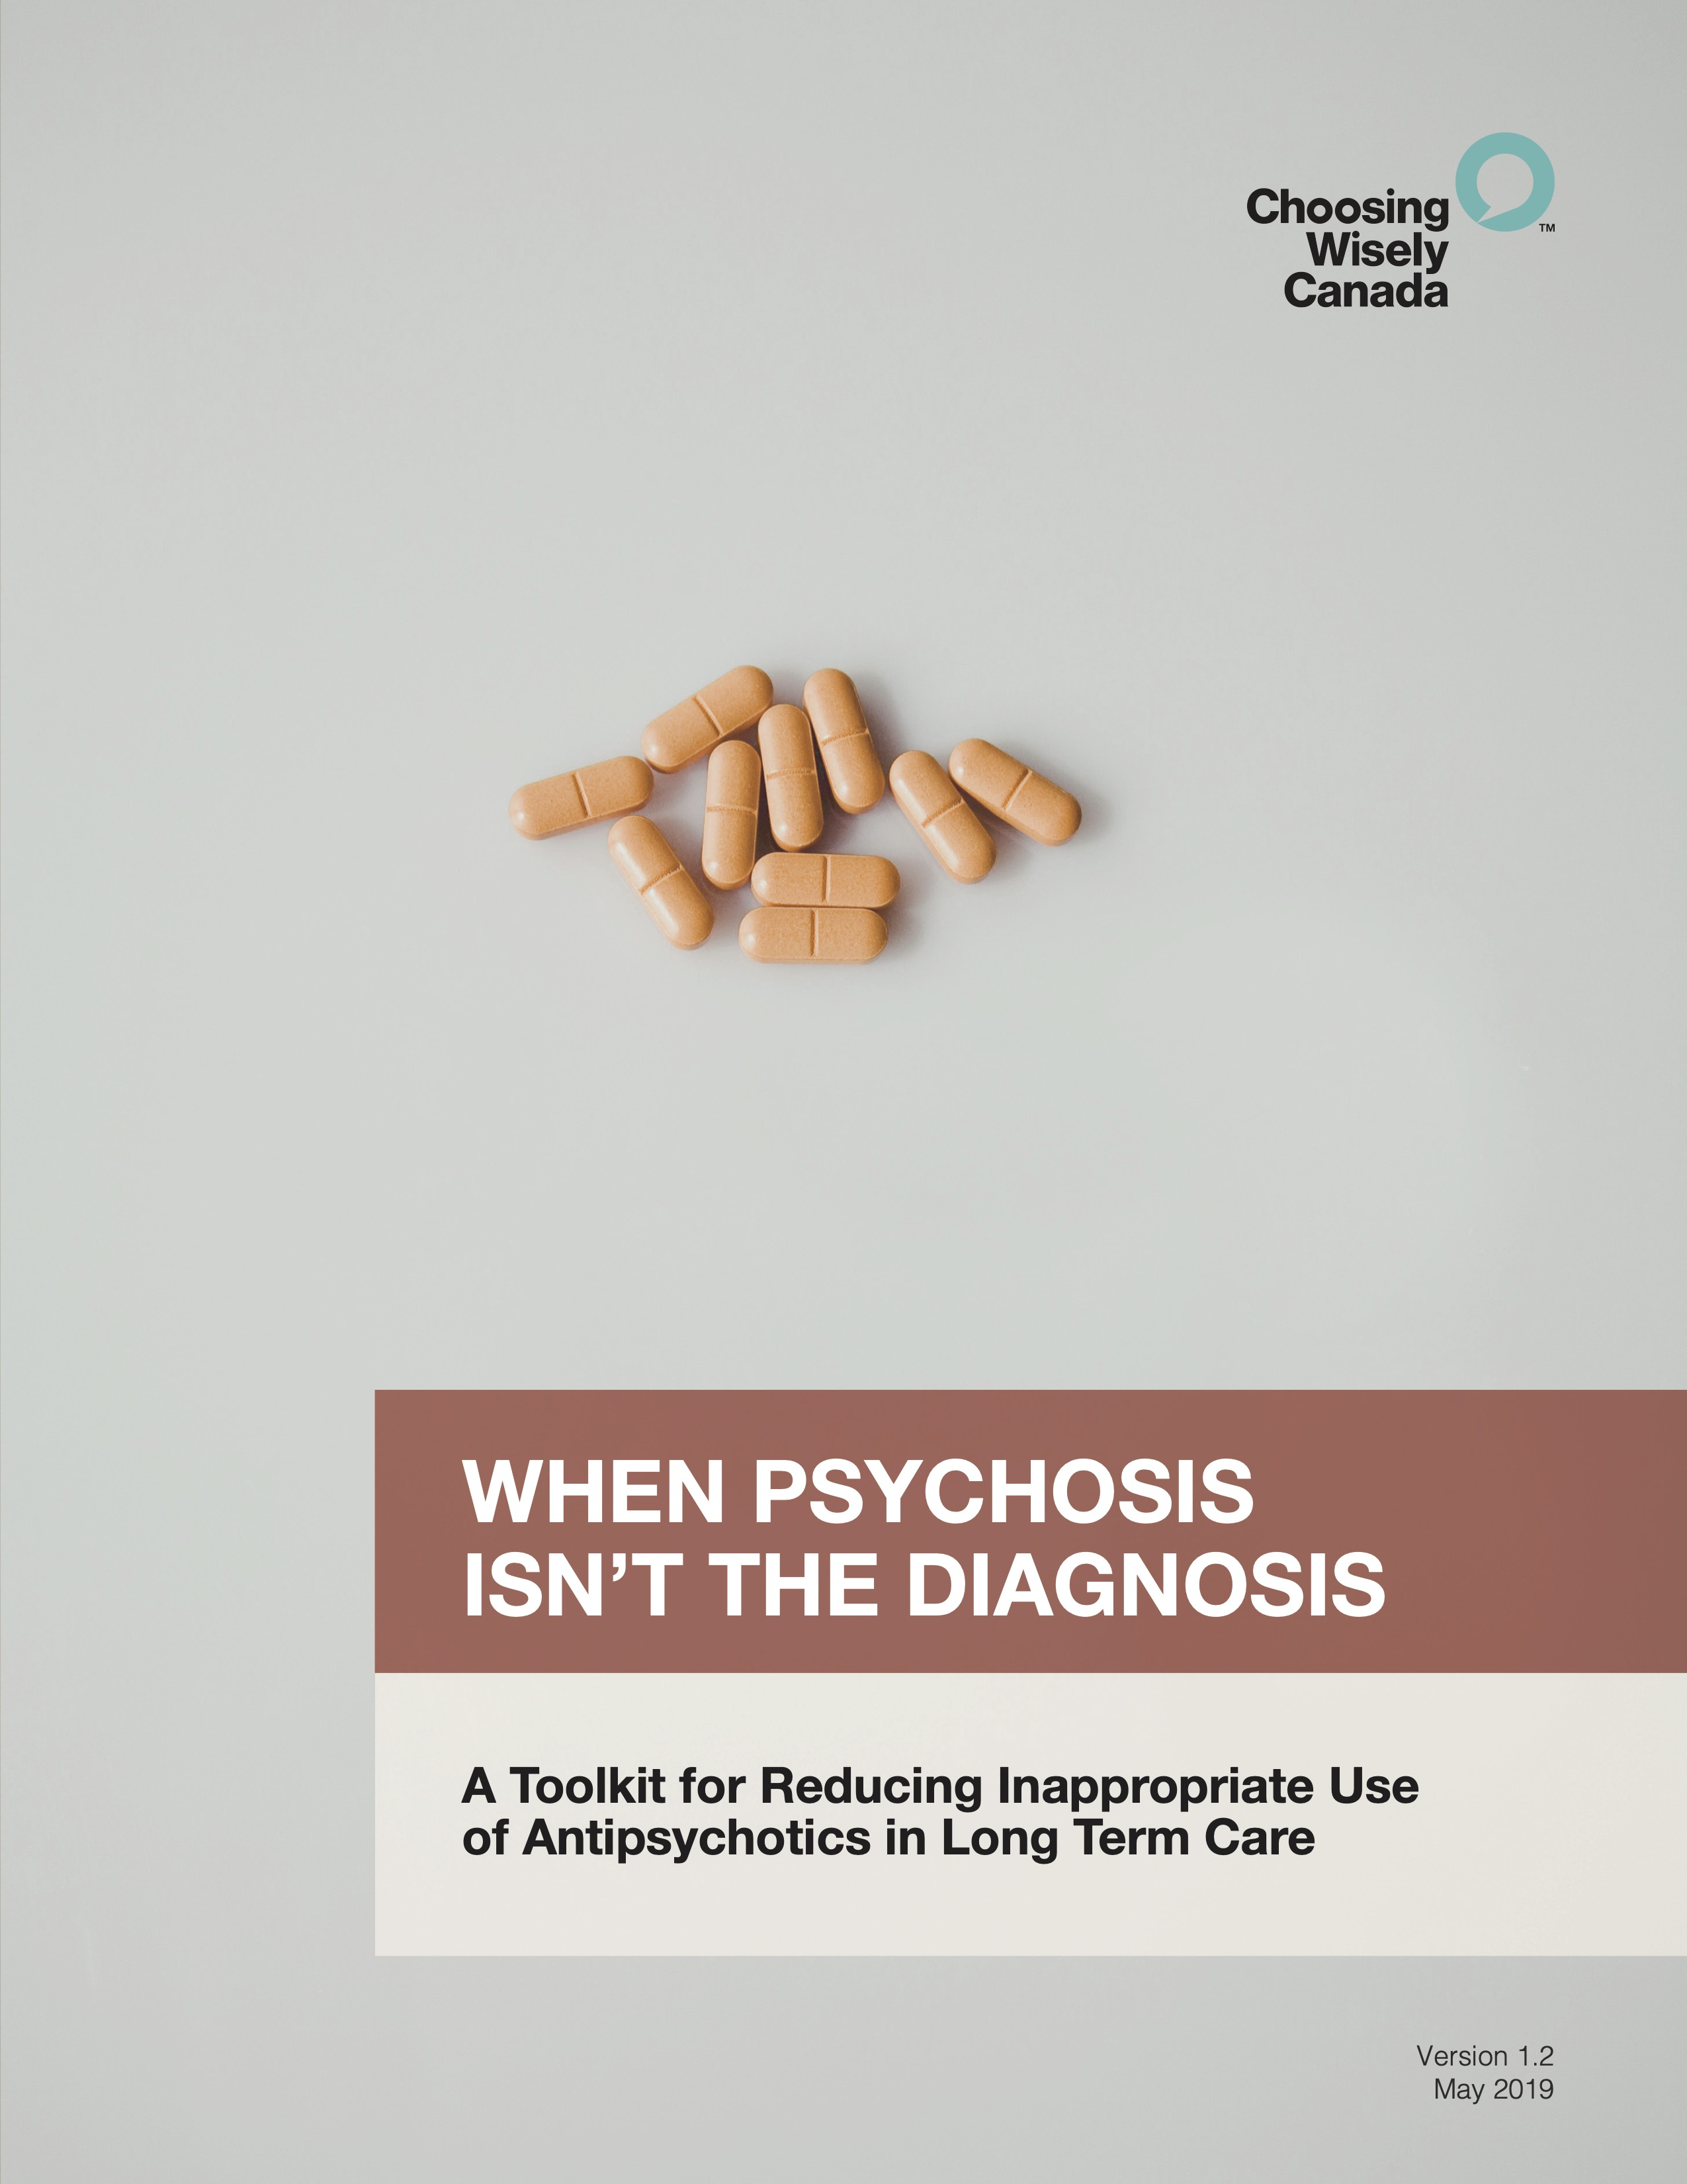
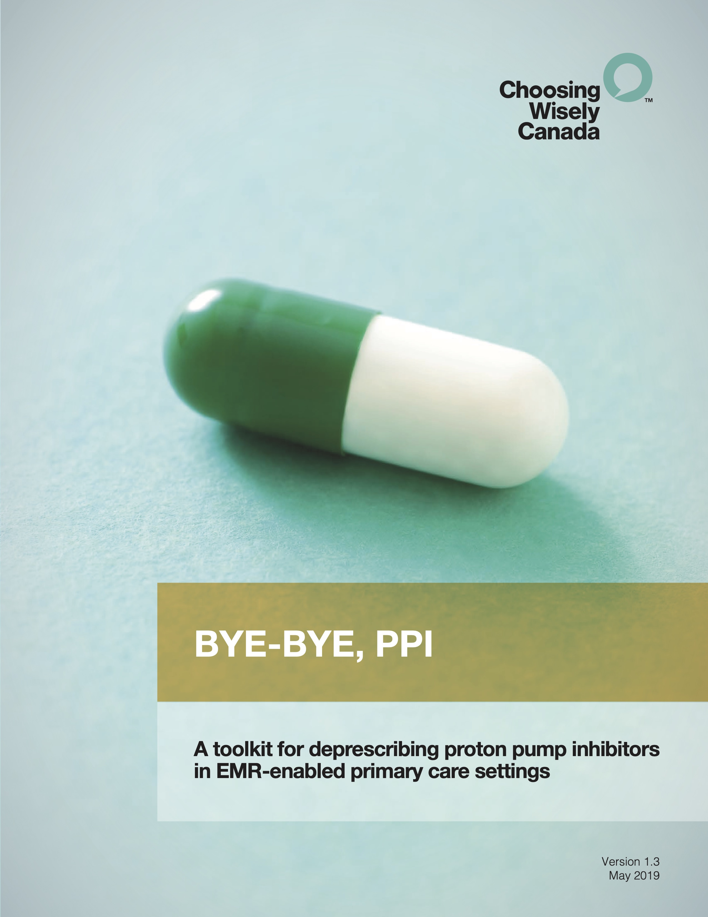
Choosing Wisely
choosingwiselycanada.org

Slide 30
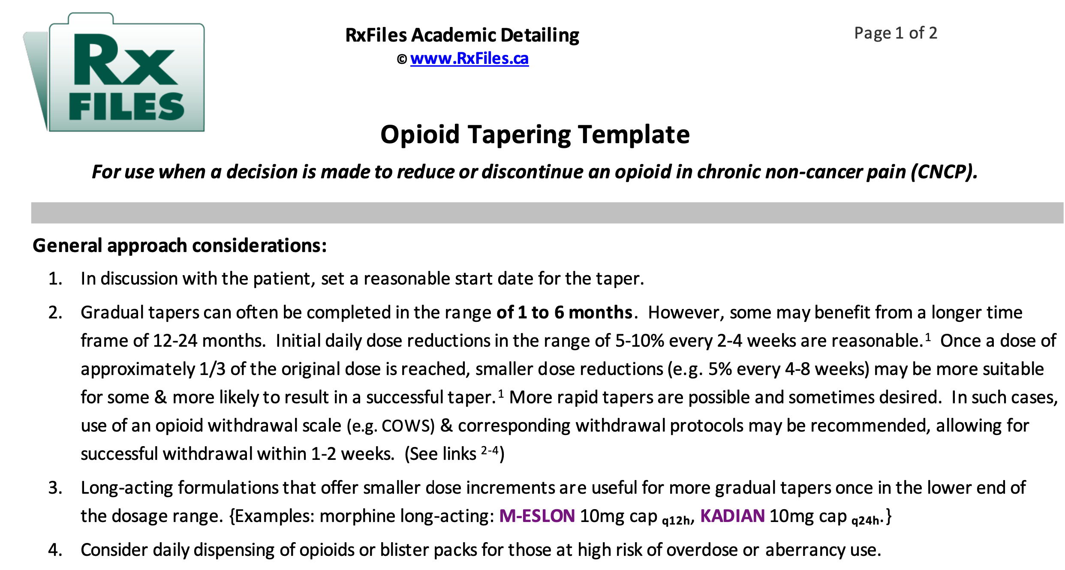
RxFiles Opioid Tapering Template
https://www.rxfiles.ca/rxfiles/uploads/documents/opioid-taper-template.pdf

Slide 31
Geri RxFiles
Tapering and Deprescribing Medications

Slide 32
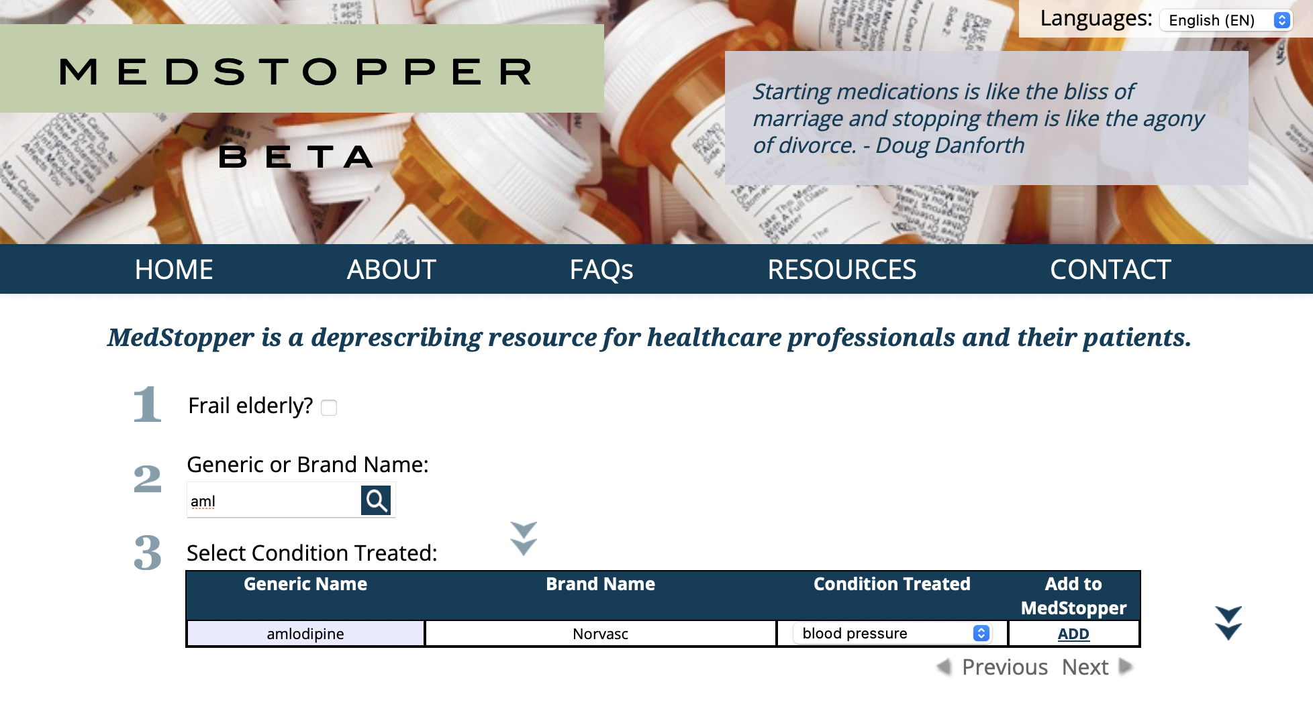
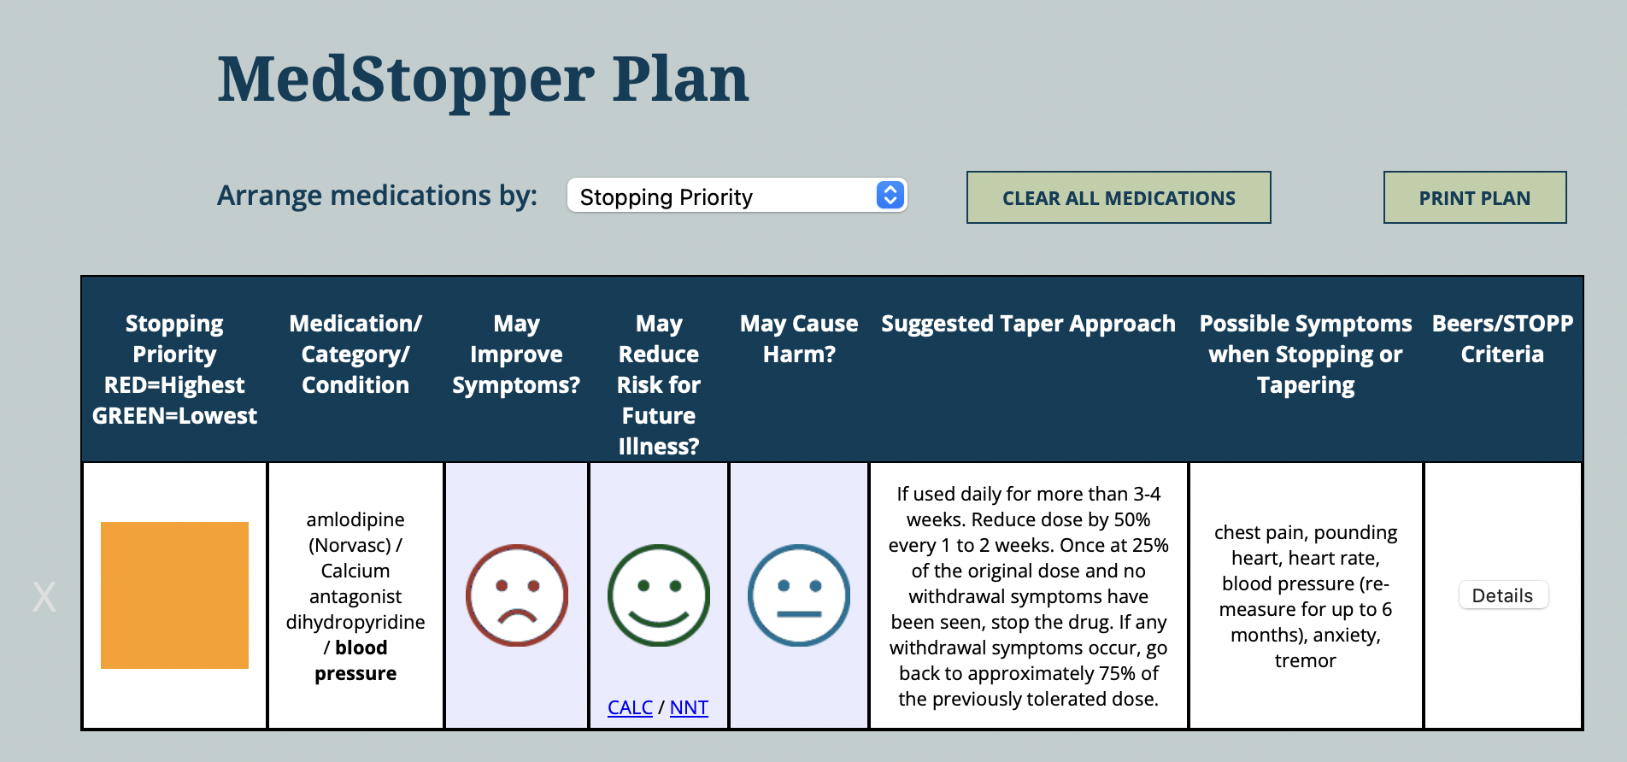
Medstopper.com

Slide 33

Potential Deprescribing CVD Examples
Beta-blockers post-MI
Statins in older patients
ASA for primary prevention
Use of alpha blockers and central agonists for hypertension

Slide 34
Summary
Polypharmacy in the elderly is prevalent in Canada and worldwide
Polypharmacy can lead to negative consequences
Consider deprescribing to minimize these consequences
There are many tools available to guide deprescribing
Work with the patient to develop a plan which aligns with patient specific goals of care

Slide 35
Questions and Discussion

