Slide 1
Insomnia in Seniors
Dr Ashok Krishnamoorthy
MD FRCPC MRCPsych

Slide 2
Disclosure
Speaker fee – AbbVie, EISAI, Lundbeck
Honoraria for Advisory board - AbbVie

Slide 3
Learning objectives
To outline key factors in the assessment of Insomnia in older adults
To familiarize practical management aspects in day to day practice
To address sleep issues in complex presentations in Seniors

Slide 4
What is Insomnia ??
sleep disorder characterized by difficulty falling asleep, staying asleep, or both, even if you have ample time and a bedroom environment conducive to restful sleep
DSM 5 - Sleep-wake disorder
Challenges falling asleep (onset insomnia): inability to fall asleep beyond 20-30 minutes
Inability to maintain sleep (middle insomnia): frequent waking during the night after sleep onset beyond 20-30 minutes, and difficulty returning to sleep after mid-night waking
Early-morning wakefulness (late insomnia): waking at least 30 minutes before the desired time and before sleep reaches 6.5 hours (often accompanied by an inability to resume sleep at all)

Slide 5
Insomnia - 2
sleep difficulty is present at least 3 nights per week and for a period of at least 3 months
you’re unable to sleep even with ample opportunity
no other sleep-wake disorder, substance, or coexisting mental health condition explains the insomnia experience

Slide 6
Insomnia -3
Short-term insomnia
At least 1 month but less than 3 months.
Chronic insomnia
insomnia that lasts beyond 3 months.
Additional categories:
persistent (lasting 3 months or longer)
recurrent (two or more episodes within a single year)
Other specifiers :
with non-sleep disorder mental comorbidity (occurring alongside another condition, including substance use disorder)
with other sleep disorders
with another medical comorbidity (occurring alongside a physical condition)

Slide 7
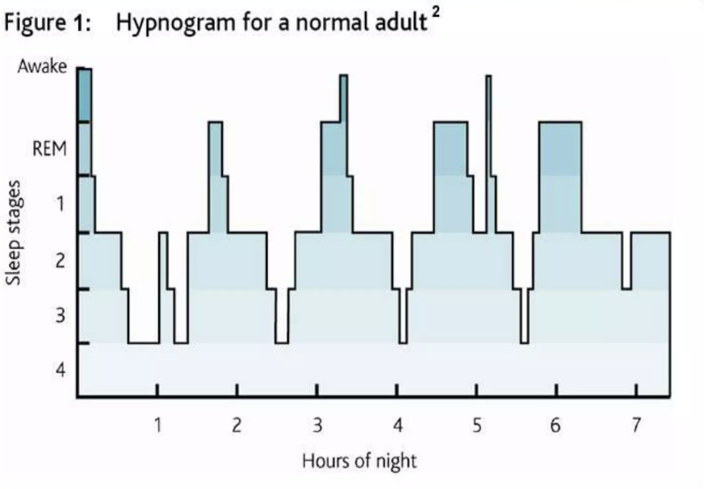
Sleep Architecture

Slide 8
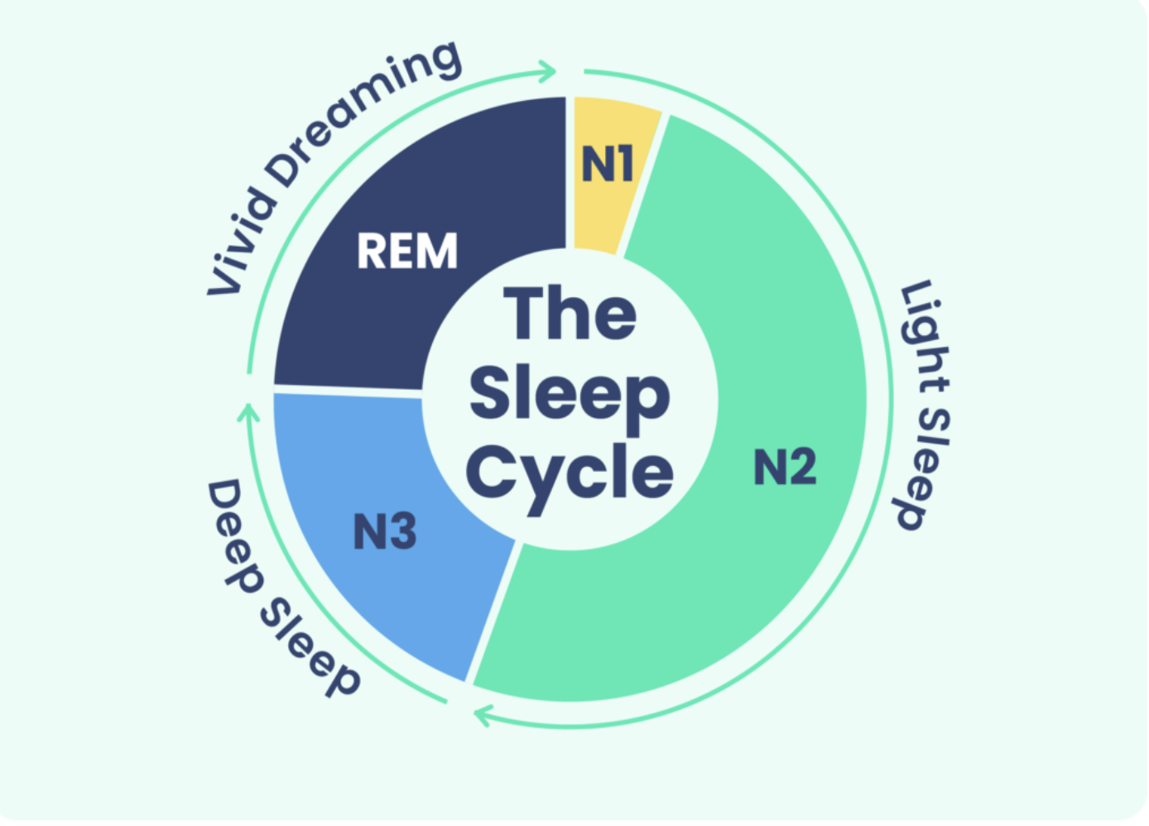
Sleep Cycle

Slide 9
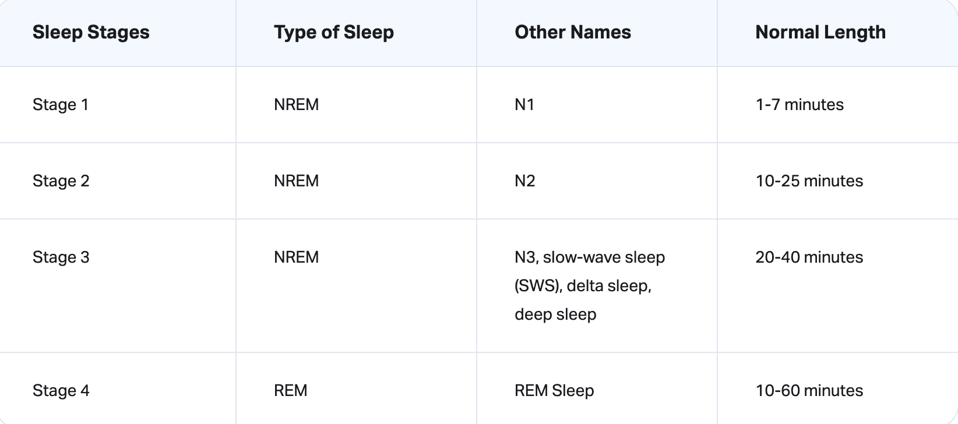
Time spent in each stage of sleep

Slide 10
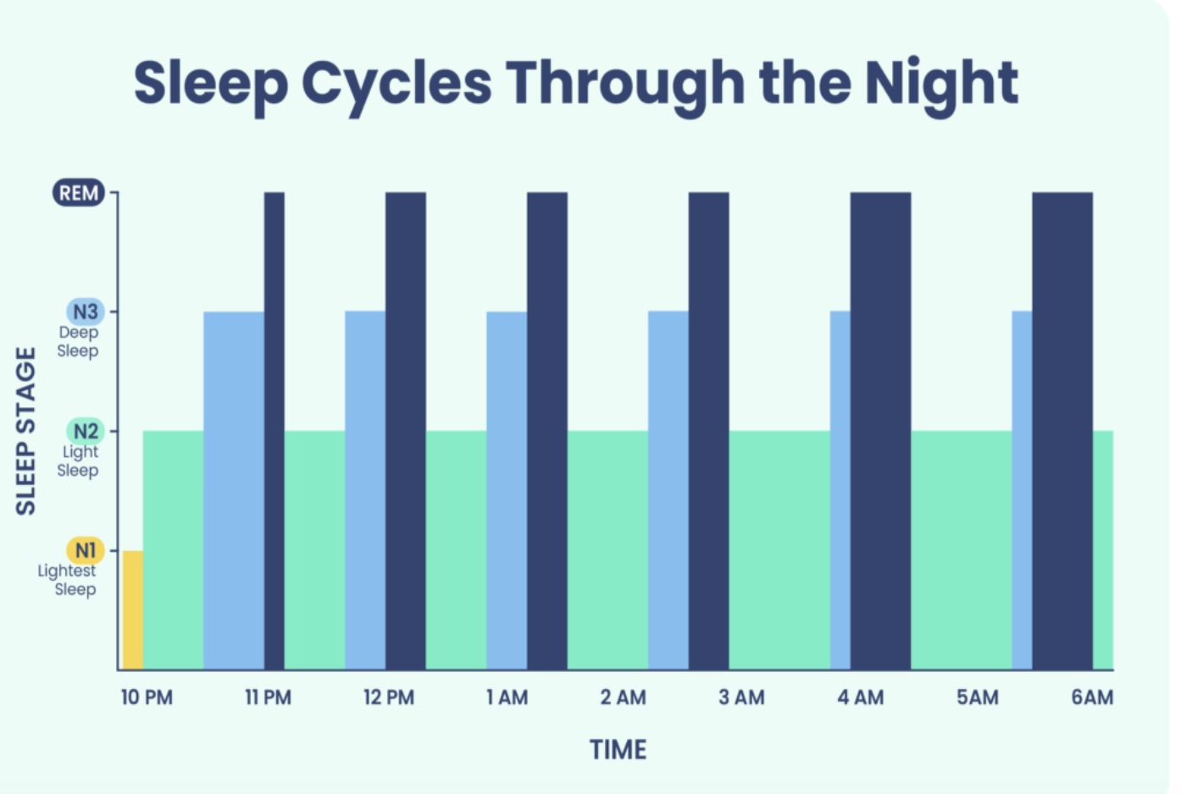

Slide 11
Aging and Sleep
The total sleep time (TST) decreases with age
Approximately 10 – 12 minutes reduction per decade of age in the adult population
Modest increase in sleep latency
Decreased sleep efficiency and quality
progressive decrease in SWS is one of the most prominent changes with aging ( more so in men)
Increased bouts of wakefulness

Slide 12
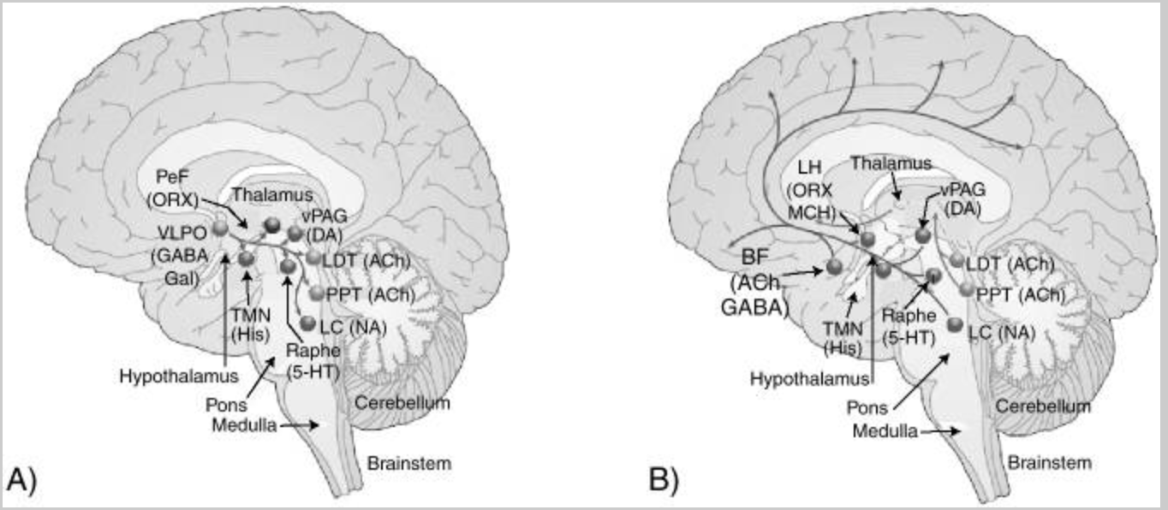
Sleep generating Wake generating

Slide 13
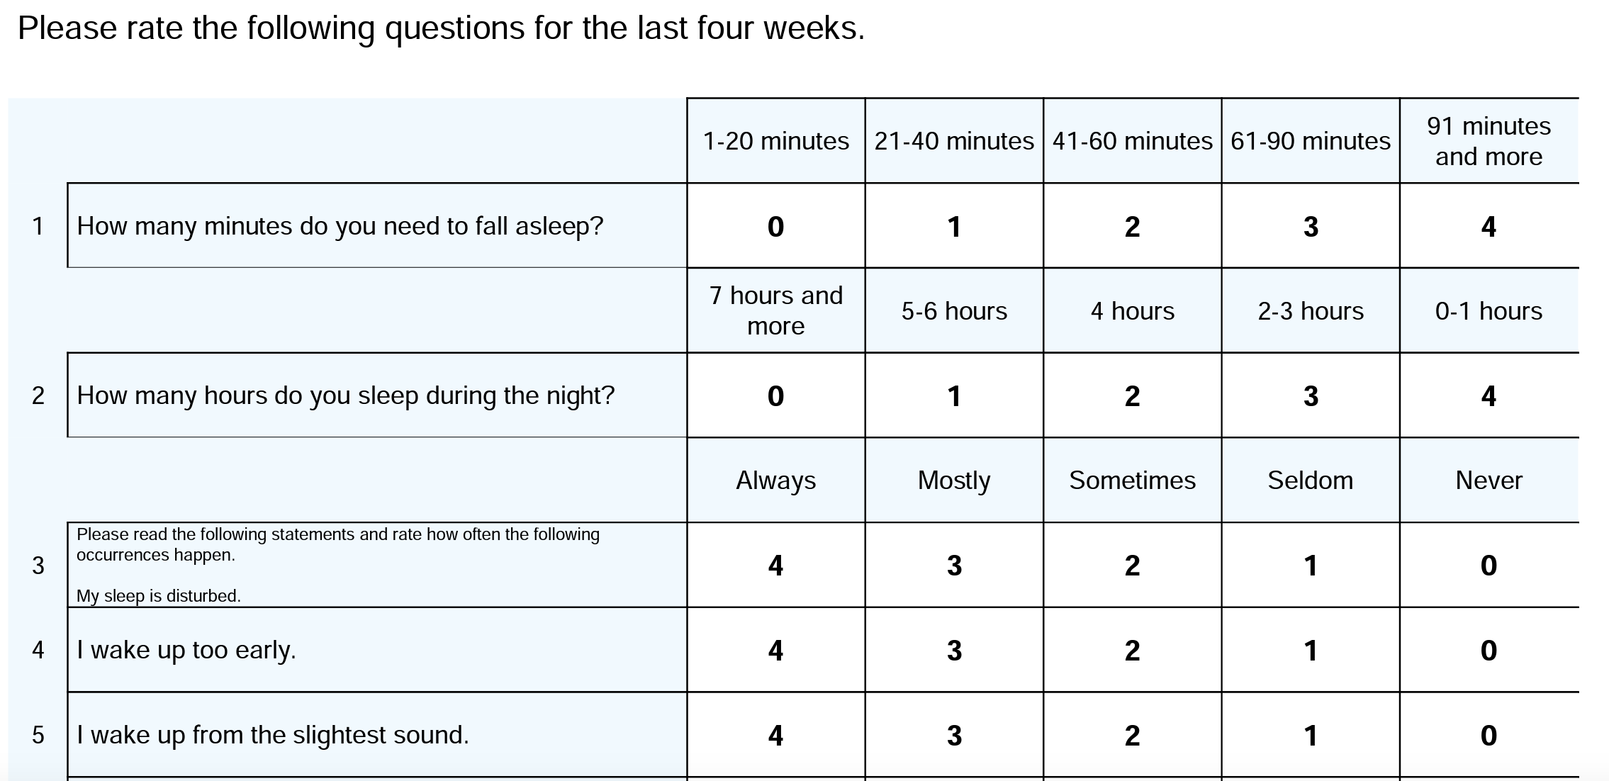
Regensburg Insomnia Scale (RIS)

Slide 14
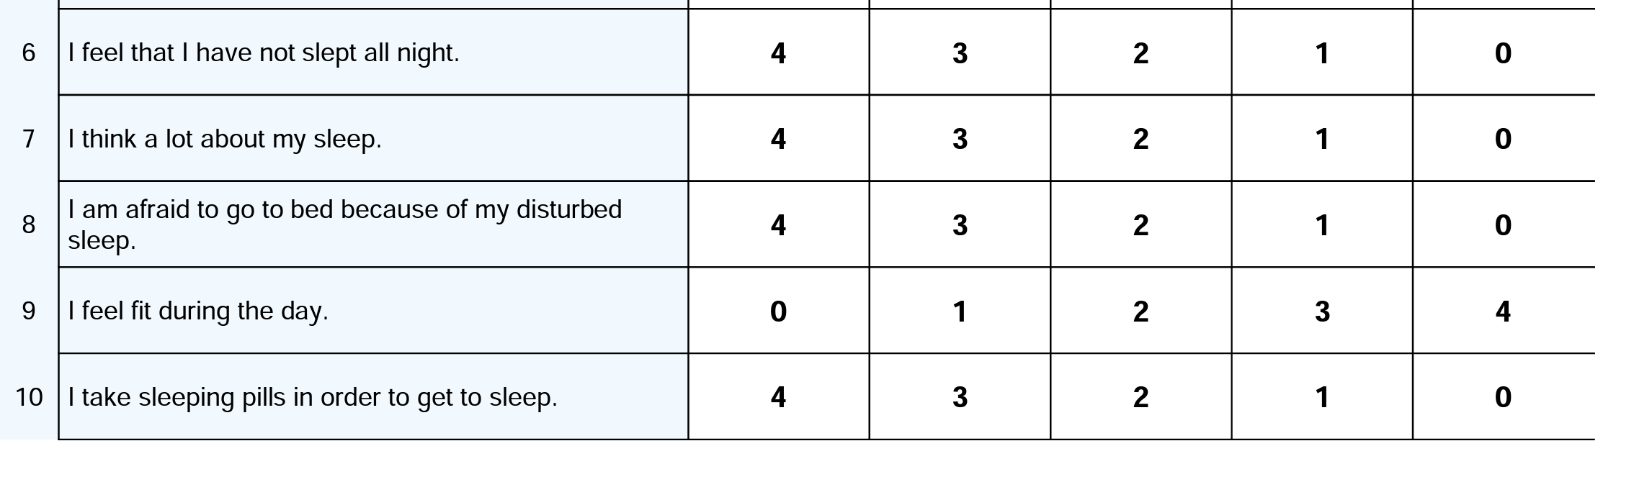
Regensburg Insomnia Scale (RIS)-2

Slide 15
Insomnia in Elderly
Most common sleep complaint
Prevalence 20-40 % (9-15% in Adult population)

Slide 16
Insomnia - consequences
Fatigue
mood changes
poor cognition
daytime sleepiness and impairment in functioning.
increased chances of developing mental illness
Accidents
poorer quality of life, and greater health‐ care utilization.

Slide 17
Evaluation
Detailed sleep history including from the partner /spouse
Medical history
Psychiatric history

Slide 18
Sleep history
Lifelong pattern of sleep, duration of sleep
long sleeper Vs short sleeper
Difficulty falling asleep
Waking up early (More than 30 mins )
Fragmented/ frequent awakening and taking more than 20 mins to fall asleep again
Not feeling rested in the morning
Day time tiredness, fatigue, irritability
Day time naps /sleepiness/poor concentration
Loud snoring,apneic spells, sleep related limb movements
Night mares /vivid dreams/enacting dreams
Sleep talking /sleep walking

Slide 19
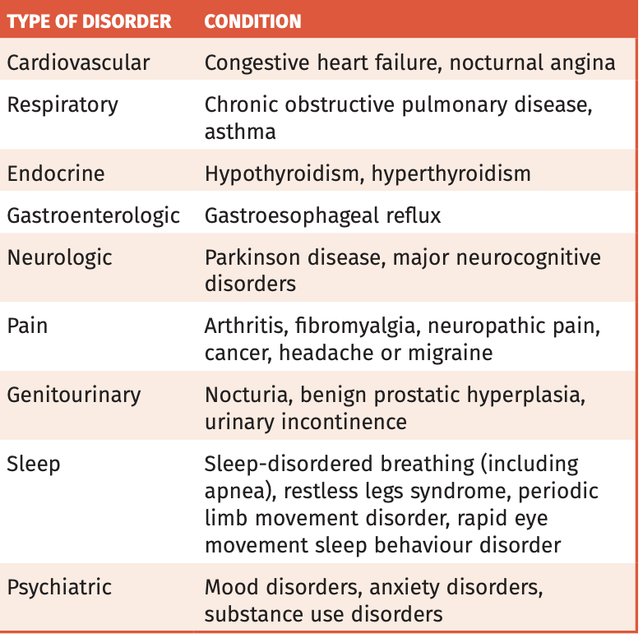
Medical history

Slide 20
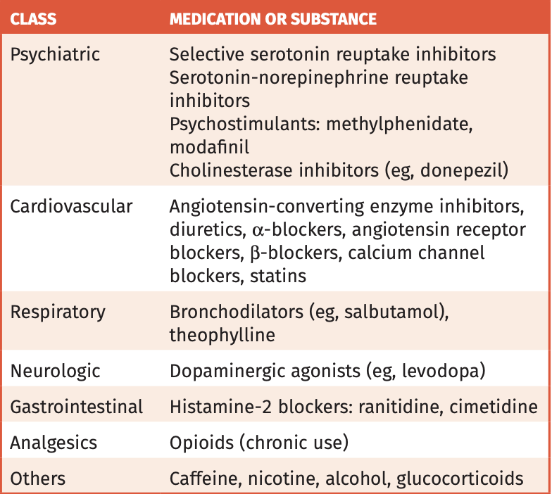
Medications

Slide 21
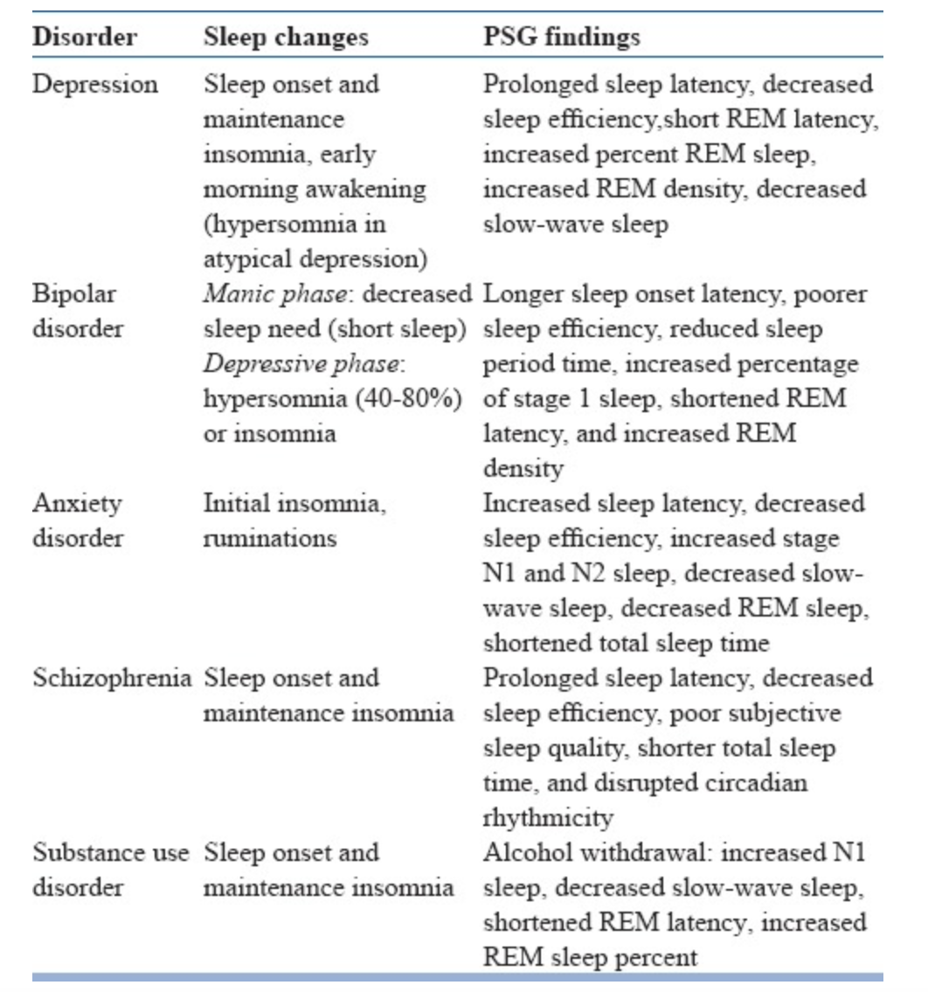
Psychiatric Disorders

Slide 22
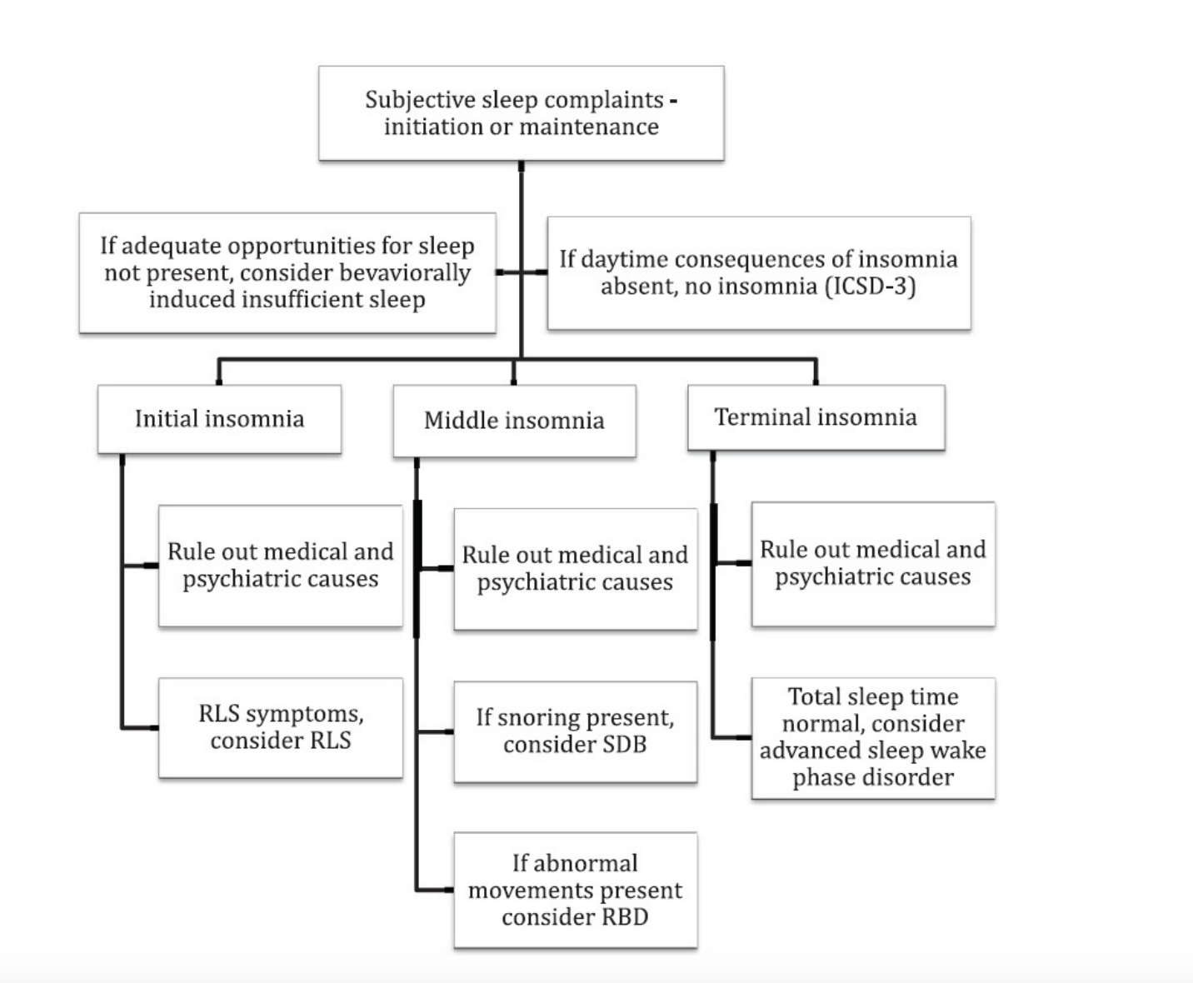
Algorithm for sleep complaints

Slide 23
Treatment Approaches
Sleep Hygiene
• Maintain a regular sleep pattern
• Avoid napping in the day
• Avoid substances that can impair sleep, including caffeine, alcohol, nicotine
• Establish a relaxing bedtime routine
• Associate the bed with sleep (avoid watching TV, working on the computer etc. in bed)

Slide 24
Stimulus-Control Therapy (SCT)
Only go to bed when sleepy
Establish a standard wake-up time
Get out of bed whenever he or she is awake for more than 15-20 minutes
Avoid reading, watching TV, eating, worrying and engaging in sleep incompatible behaviours in the bed and bedroom
Avoid clock watching
Maximize daylight exposure and minimize light exposure in evening
Avoid day time napping

Slide 25
Sleep Restriction Therapy (SRT)
Step 1: Sleep log for 2-3 weeks
Step 2: Calculate the average total sleep time (TST)
Step 3: Prescribe initial time-in-bed (TIB) at the average TST or average TST plus amount of time that is deemed to be normal nocturnal wakefulness (e.g., 30 min). TIB should not be more than 7.5 hours per night in the elderly population
Step 4: At follow-up sessions, typically weekly, increase TIB in 15-20 minute increments when sleep efficiency exceeds 85%. Sleep efficiency = time asleep/TIB. Note that wake-up time is fixed, so bedtime is advanced by 15-20 minutes, and bedtime should not be later than 2 a.m.

Slide 26
CBT-I
Cognitive therapy, sleep hygiene, relaxation training, SCT and SRT are important elements of CBT-I
Cognitive therapy: Identifying sleep-related maladaptive beliefs (cognitive distortion) and evaluating them using various tools, such as thought record
Conditioned arousal
Identifying and eliminating habits that were developed in an effort to improve sleep but have become ineffective.
Reducing sleep-related worry and other sources of heightened arousal

Slide 27
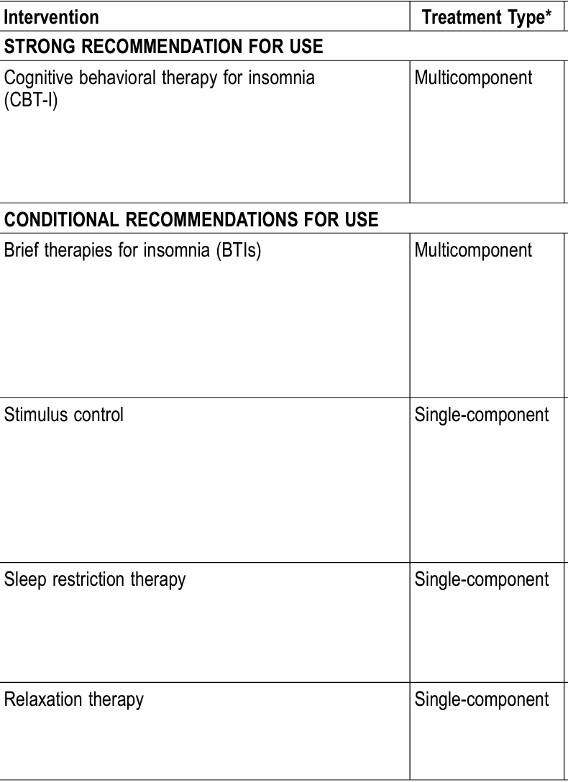
AASM – Non Pharmacological treatment

Slide 28
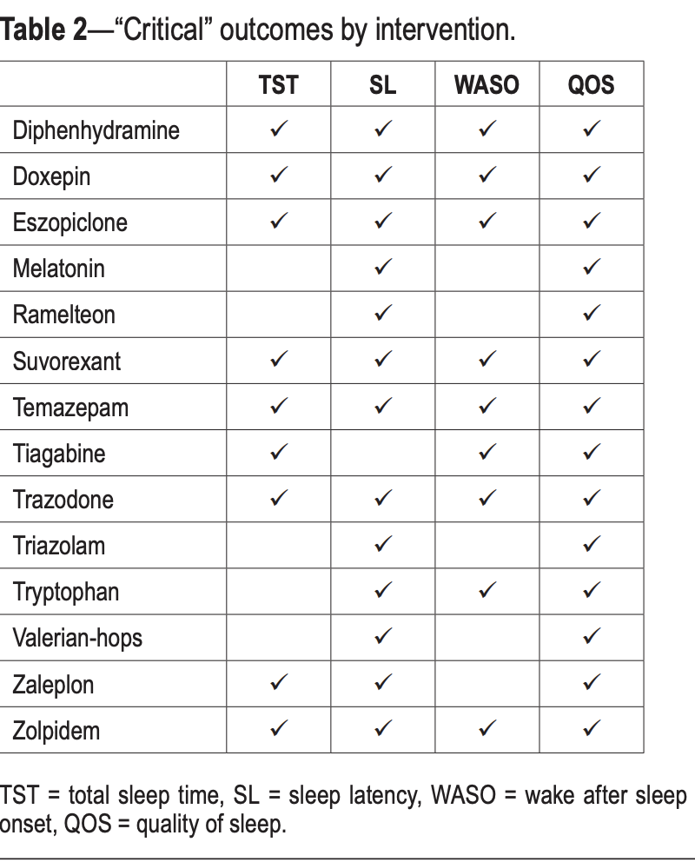

Slide 29
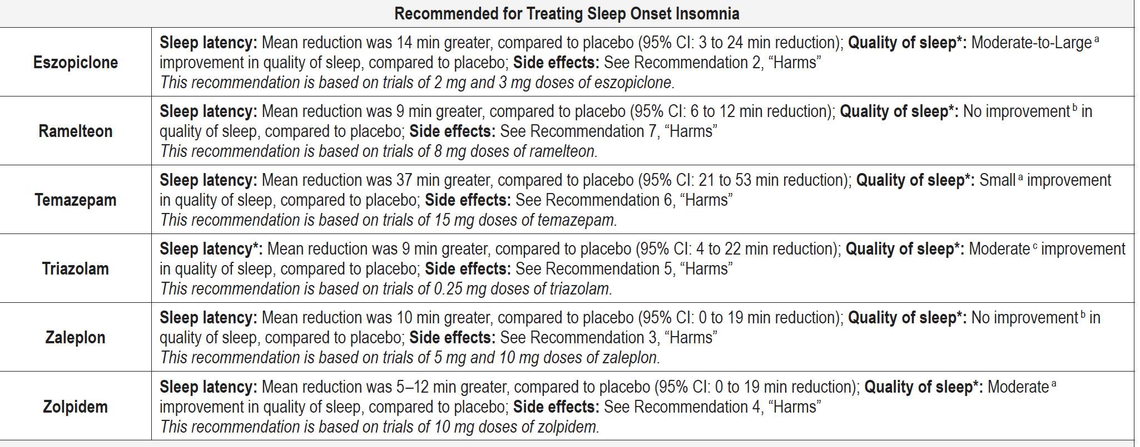

Slide 30
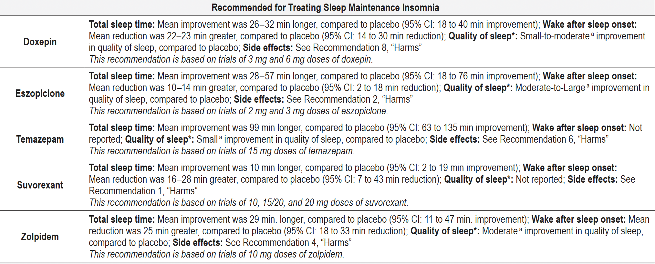

Slide 31
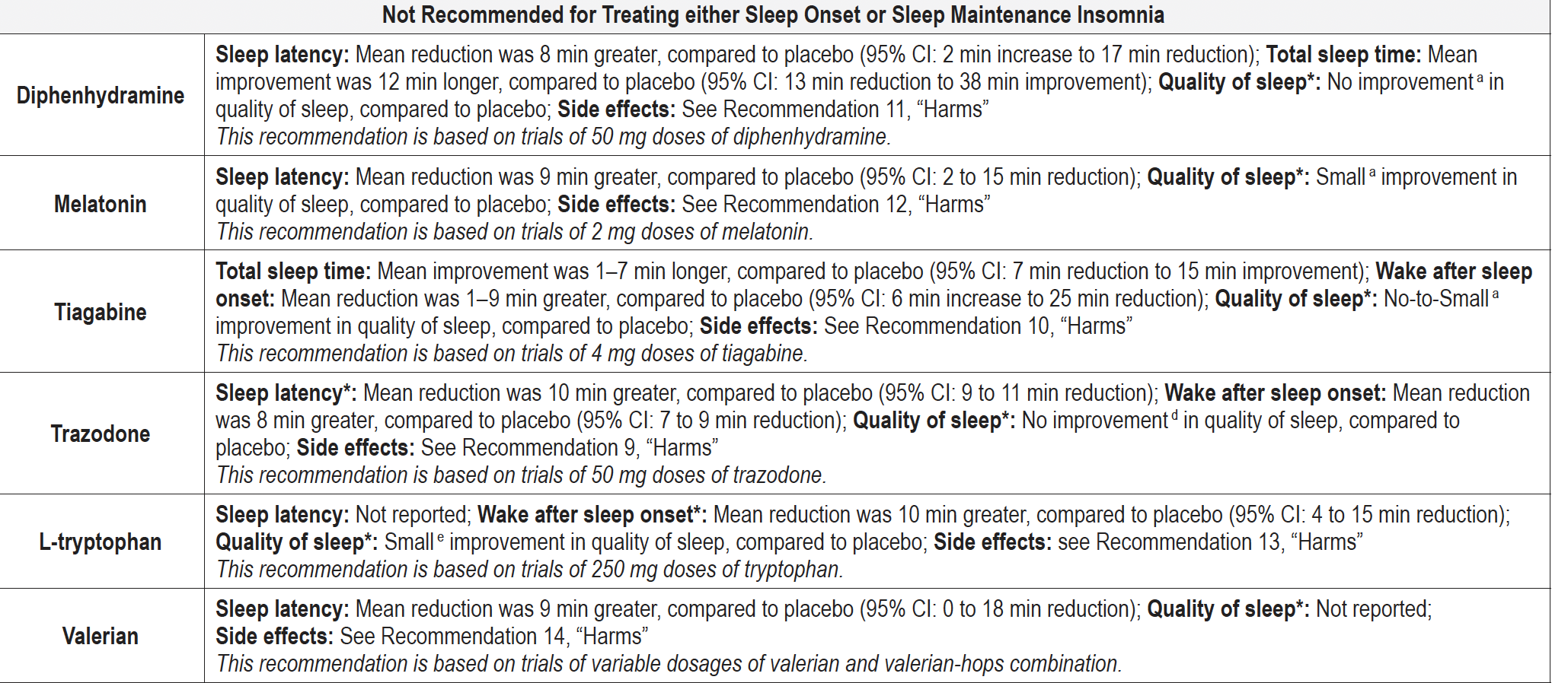
Not recommended - AASM

Slide 32
Sleep disturbances in Dementia
Cochrane Review
Trazodone -increase the total time spent asleep each night ,may improve sleep efficiency, slightly reduced the time spent awake at night
Orexin antagonists -participants slept longer at night and spent 15 minutes less time awake after first falling asleep. There was also a small increase in sleep efficiency
Melatonin - no evidence that melatonin improved sleep in people with dementia due to Alzheimer's disease

Slide 33
Sleep disturbances in Dementia
Irregular Sleep-Wake Rhythm Disorder (ISWRD)
circadian rhythm sleep disorder
the pattern of sleep and wakefulness that repeats itself over a 24-hour period in healthy individuals
In AD it is broken down ,sleeping and waking occur instead at various times during the day and night
Treatment – Orexin Antagonists - increased total sleep time and decreased wakefulness after sleep onset. No major adverse events were observed, consistent with a restoration of the normal diurnal/circadian rhythm

Slide 34
Thank you

