Slide 1

Managing heart failure in elderly patients
Tarun Sharma, MD
September 16, 2023

Slide 2
Disclosure
Novartis, Servier Canada, BI Canada: speaking engagement

Slide 3
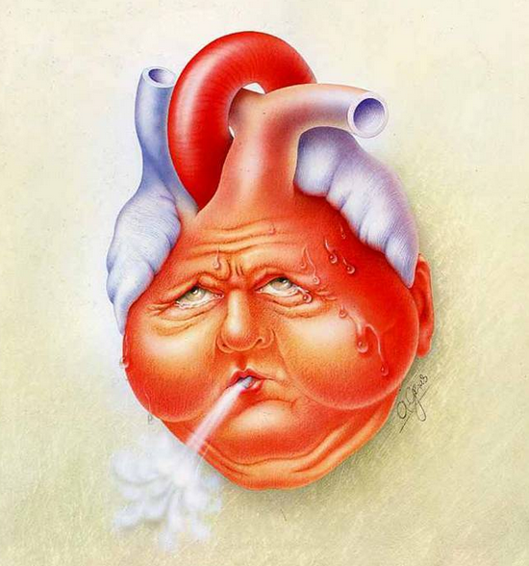
Outline
Definition
Heart failure statistics
Burden of heart failure in elderly
Burden of heart failure in South Asians
Practical management
Prognosis and goals of care

Slide 4
Heart Failure
Inability of heart to meet metabolic demands of the body
Reduced EF (HFrEF, HFmrEF)
Need high pressures to keep up (HFpEF)

Slide 5
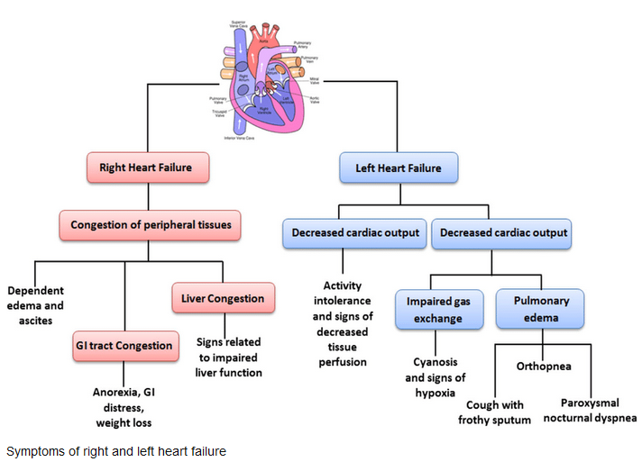
Clinical presentation

Slide 6


Statistics
750,000 patients with heart failure
>100,000 patients diagnosed per year
>2.8 billion/year in healthcare cost by 2030

Slide 7
Aging population
UN definition:
  7% or more of its population aged ≥65 years as an “aging society”
  14% or more as an “elderly society”
  21% or more as a “super-aged society”
BC: 2016 consensus
  18% population is over age 65

Slide 8
Heart Failure increases with age
In US population data:
  HF risk 6% from 60-79 years age
  Increases to 14% over age 80
  Risk of HF hospitalization triples over age 80
Modified from Kannel WB, Belanger AJ. Epidemiology of heart failure. Am Heart J 1991;121:951-957.

Slide 9
Risk factors for development of HF
In 1 study, following population risk factors:
  Coronary artery disease [RR 8.1]
  Smoking [RR 1.6]
  Hypertension [1.4]
  Obesity [RR 1.3]
  Diabetes [1.9]
  Valvular heart disease [RR 1.5]
Older age, arrhythmias, kidney disease, COPD. social determinants of health

Slide 10
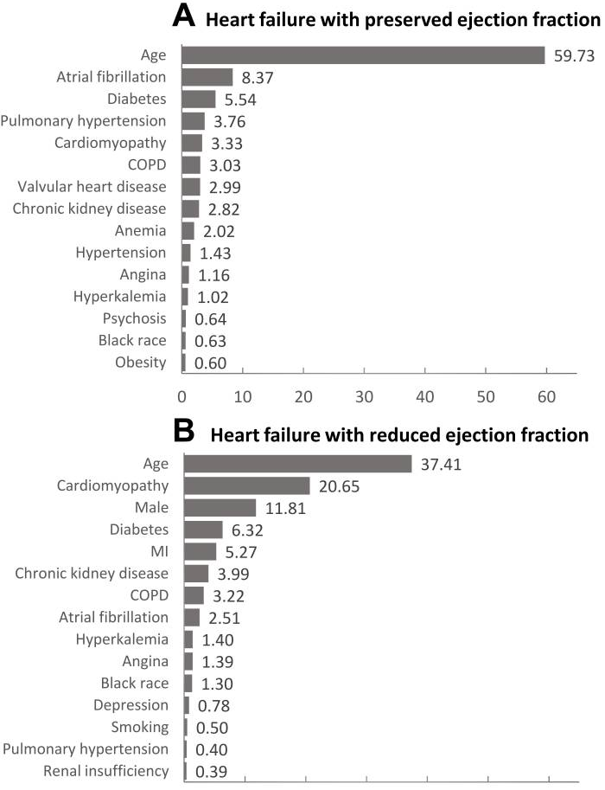
Distribution of heart failure type
Reduced EF more common in younger patients
  PREVEND study (2013)
  Cohort study of middle age patients with 11 year follow up
    66% HFrEF (LVEF<40%) and 34% HFpEF (LVEF>50%)
Preserved EF more common in older patients
  Patients have more comorbidities

Slide 11
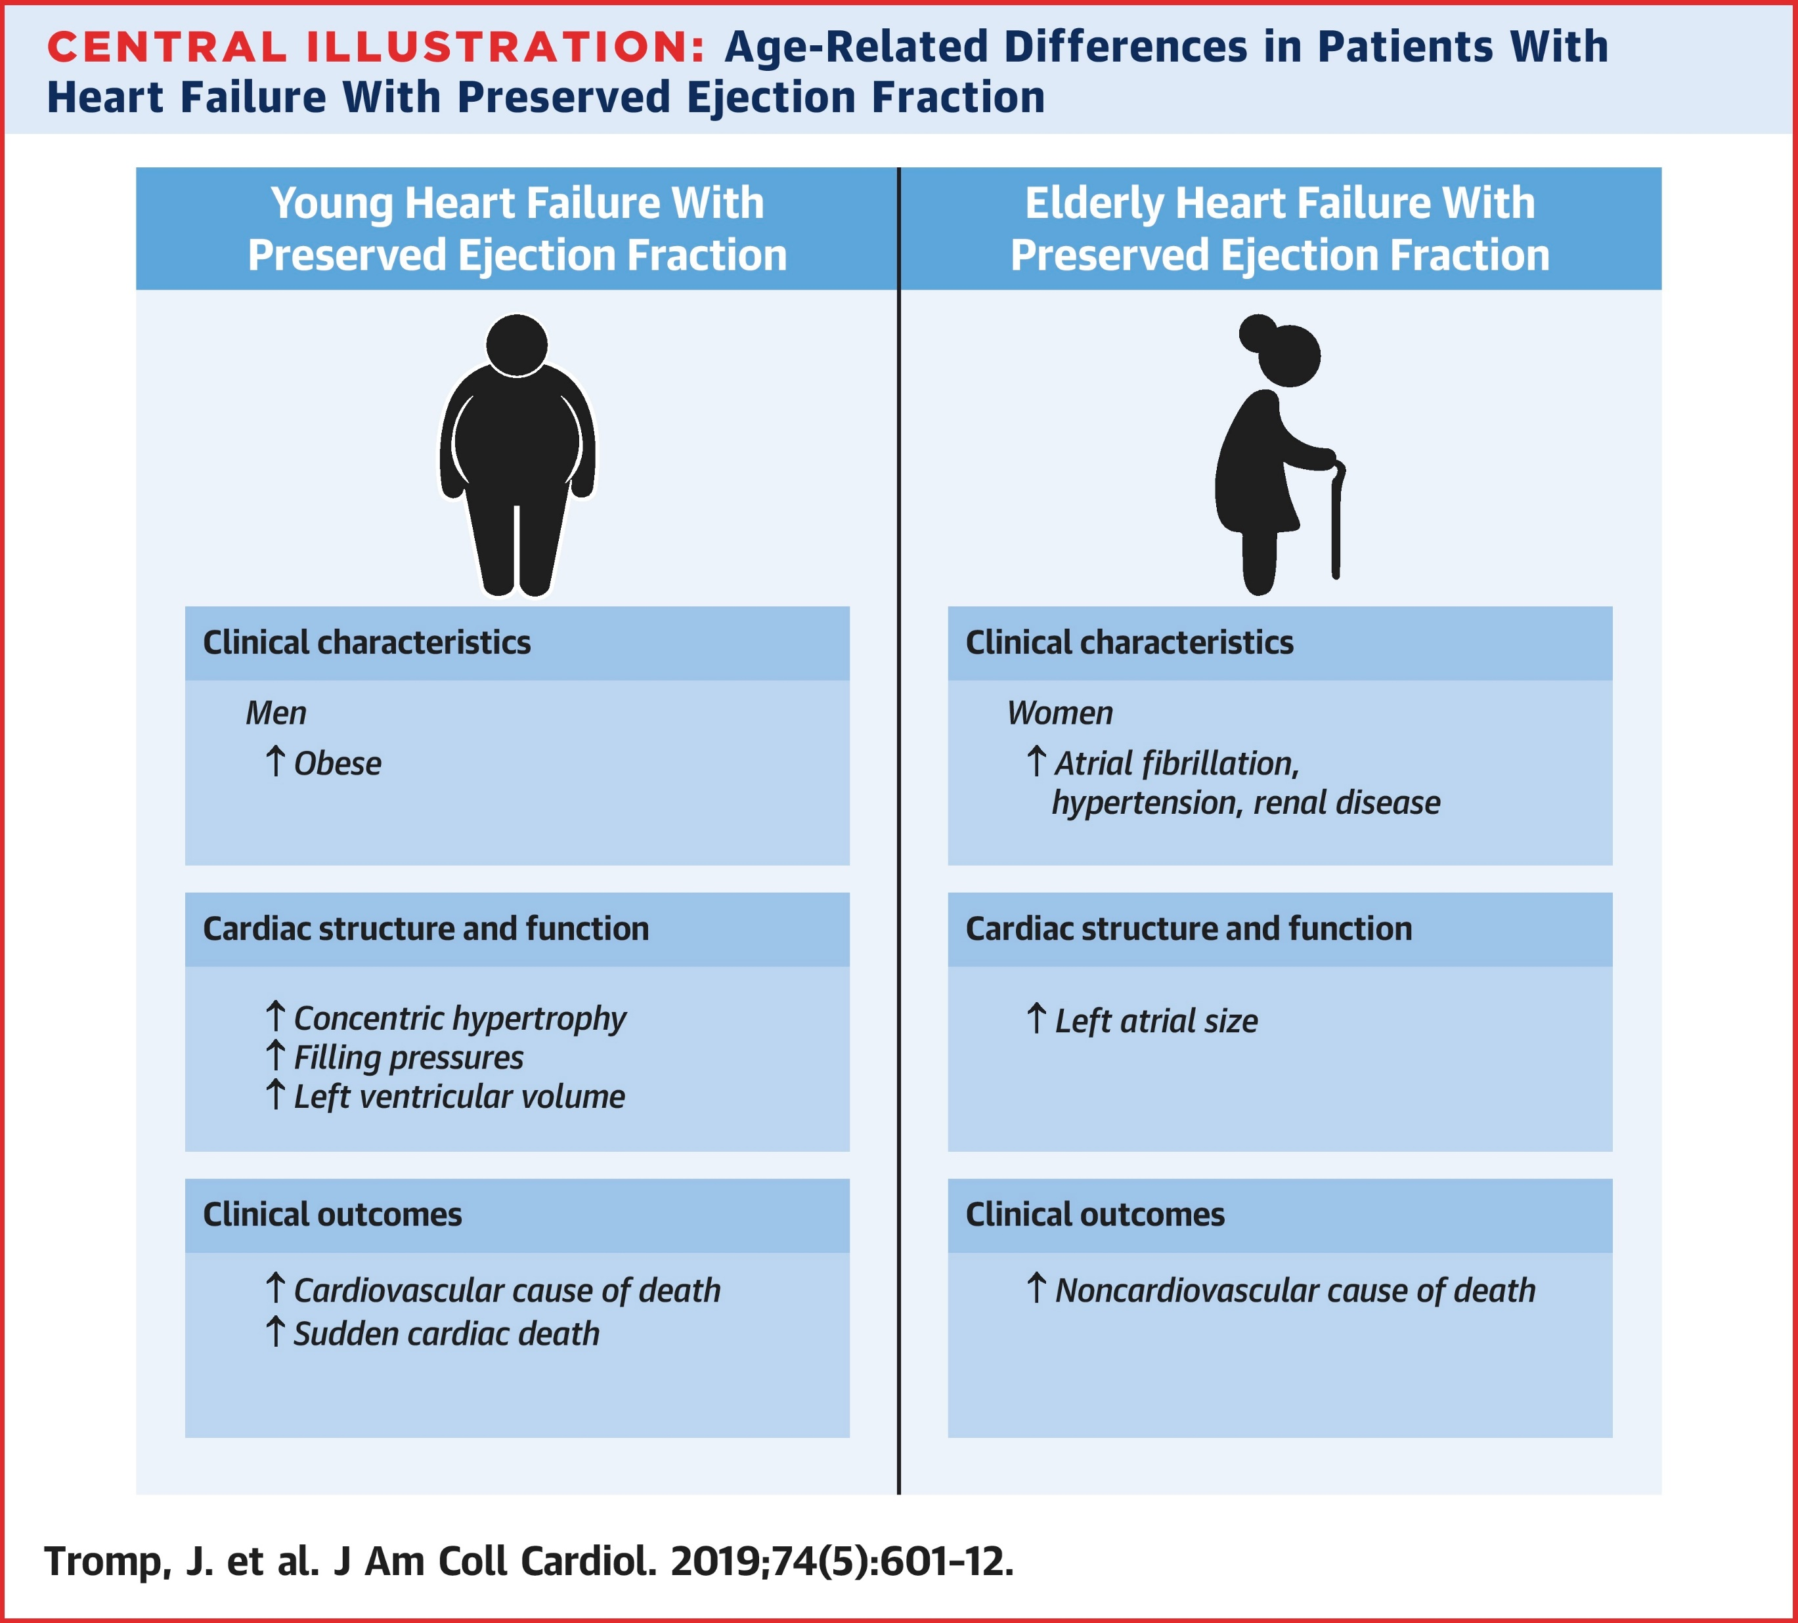
Profile of elderly heart failure patient

Slide 12
What about South Asians and heart failure?

Slide 13
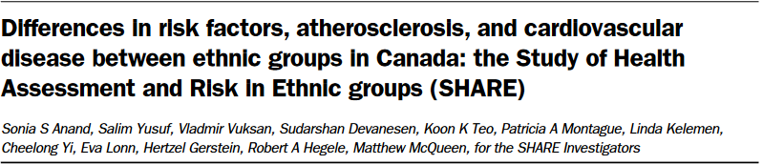
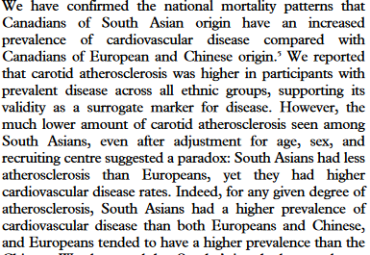


CAD and South Asians
Risk factor for premature CAD
  In Canada, South Asians have highest CV disease (data from 1979-1993)
  Younger
  Larger MI
  More severe CAD on angiography
Increased risk is not explained solely by traditional risk factors

Slide 14
South Asians and HF
ASIAN-HF study
  SA patients were younger (57.8 y/o vs 62.1)
    more CAD (51% vs 38%), more DM2 (37% vs 31%)
Choi et al in Ontario 2000-2011
  Average SA patient about 8 years younger than Chinese patient, 5 years younger than others
  More diabetes, CAD s/p MI, 3 vessel disease, more revascularization

Slide 15
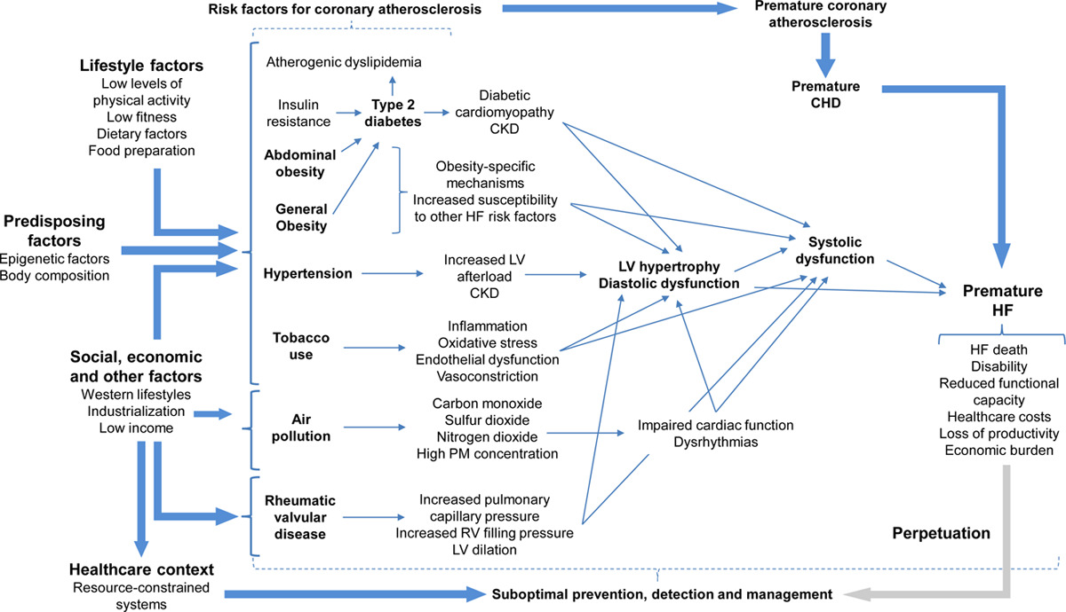
Risk factors for HF in South Asians

Slide 16
Risk of heart failure
ELDERLY
SOUTH ASIAN

Slide 17
Treatment for decreasing mortality /hospitalization /worsening HF
Reduced EF (HFrEF, LVEF <40%)
  Beta blocker
  ARNI (or ACE-i/ARB)
  MRA (spironolactone)
  SGLT2 inhibitors
Preserved (HFpEF i.e. LVEF >50%)
  SGLT2 inhibitors
  MRA (spironolactone)
  ARB (+/- ARNI)

Slide 18
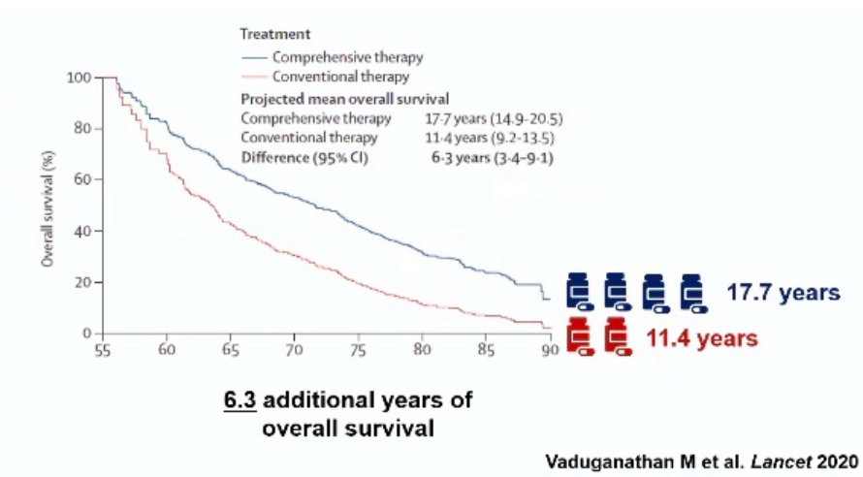
Management of HF with Reduced EF

Slide 19

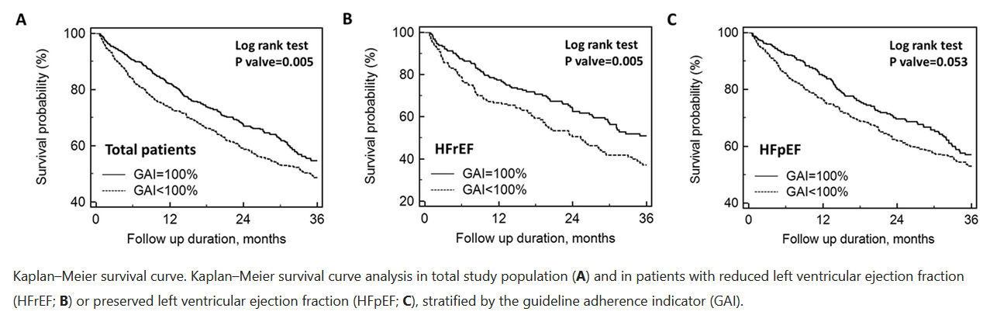
HF in the elderly
In patients > 80 years age admitted for acute heart failure

Slide 20
Heart Failure never occurs in isolation
Elderly patients:
  Cognitive impairment
  Increased frailty
    Decreased functional ability and poor exercise tolerance
    Important to distinguish from heart failure
  Depression
  Orthostatic hypotension
    Limits reaching target doses
  Polypharmacy
    Important to consider drug-drug interactions

Slide 21
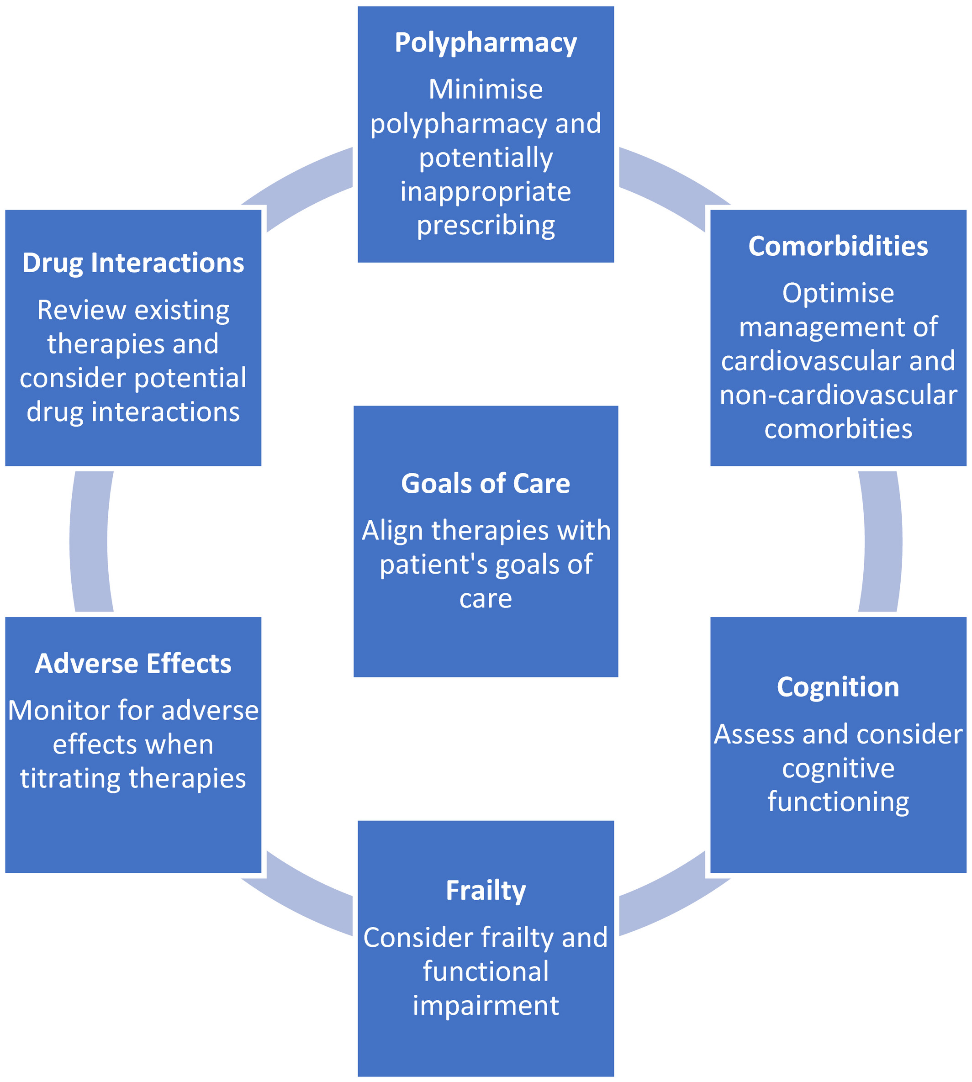

Slide 22

Practical management
Emphasizing quality of life rather than longevity
  OK to not reach target doses
Focusing on reducing HF hospitalizations
  Better volume management
Not offering therapies that are likely to cause more undesired effects
  Limiting ICD referrals
Assessing for orthostatic symptoms
  Increased fall risk (risk is as high as 43% over 2 years)

Slide 23
Practical issues with management
Hypotension
  Orthostatic hypotension
    Drop of SBP>20mmHg, DBP>10mmHg
    Complicated by autonomic dysfunction in heart failure
  Decreased hydration and oral intake
  Medication induced
    Tamsulosin etc, Diuretic predominant medication regimen in non volume overloaded patient
  Comorbidities
    Parkinson’s

Slide 24
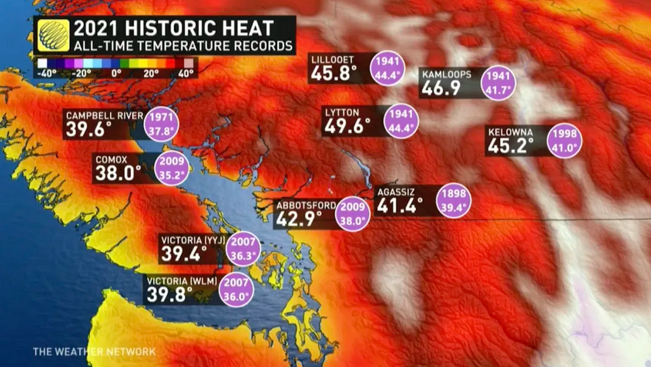
Renal failure
Prevalence reported as high as 40% in >65 years age
Heart failure medications impact renal function
Frequently exacerbated by volume depletion

Slide 25
Tailoring therapy based on patient
Important to consider where each patient is in their disease trajectory
Offer appropriate HF therapies based on patient profile
Volume/symptom management vs usual mortality reduction

Slide 26
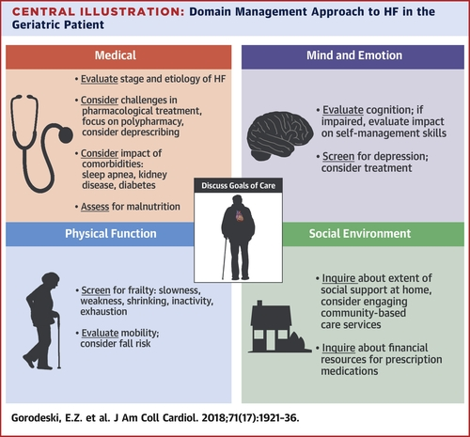

Slide 27
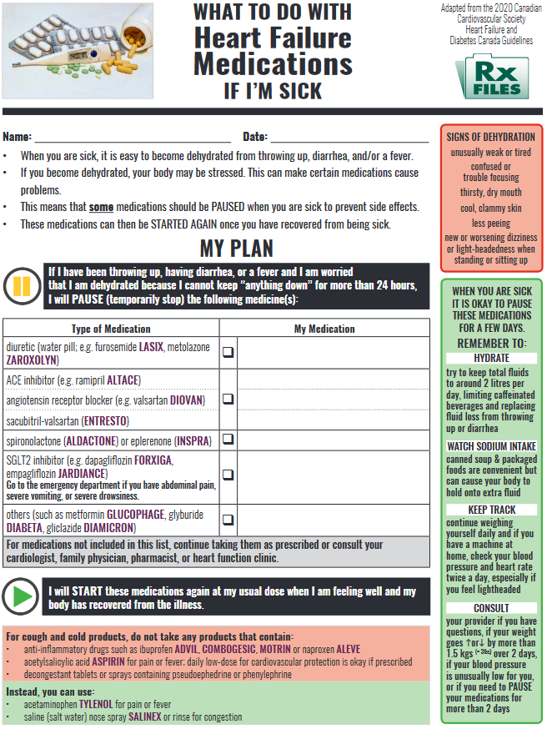
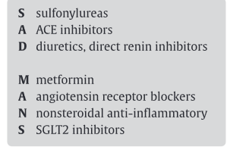

Slide 28
What about the slowly declining patient?

Slide 29
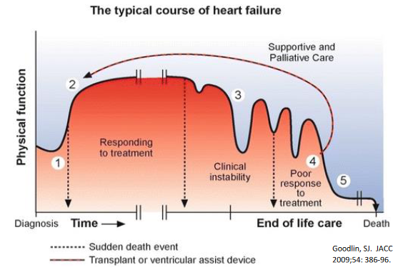

Slide 30
Recurring Hospitalizations Predict Poor Outcome

Slide 31
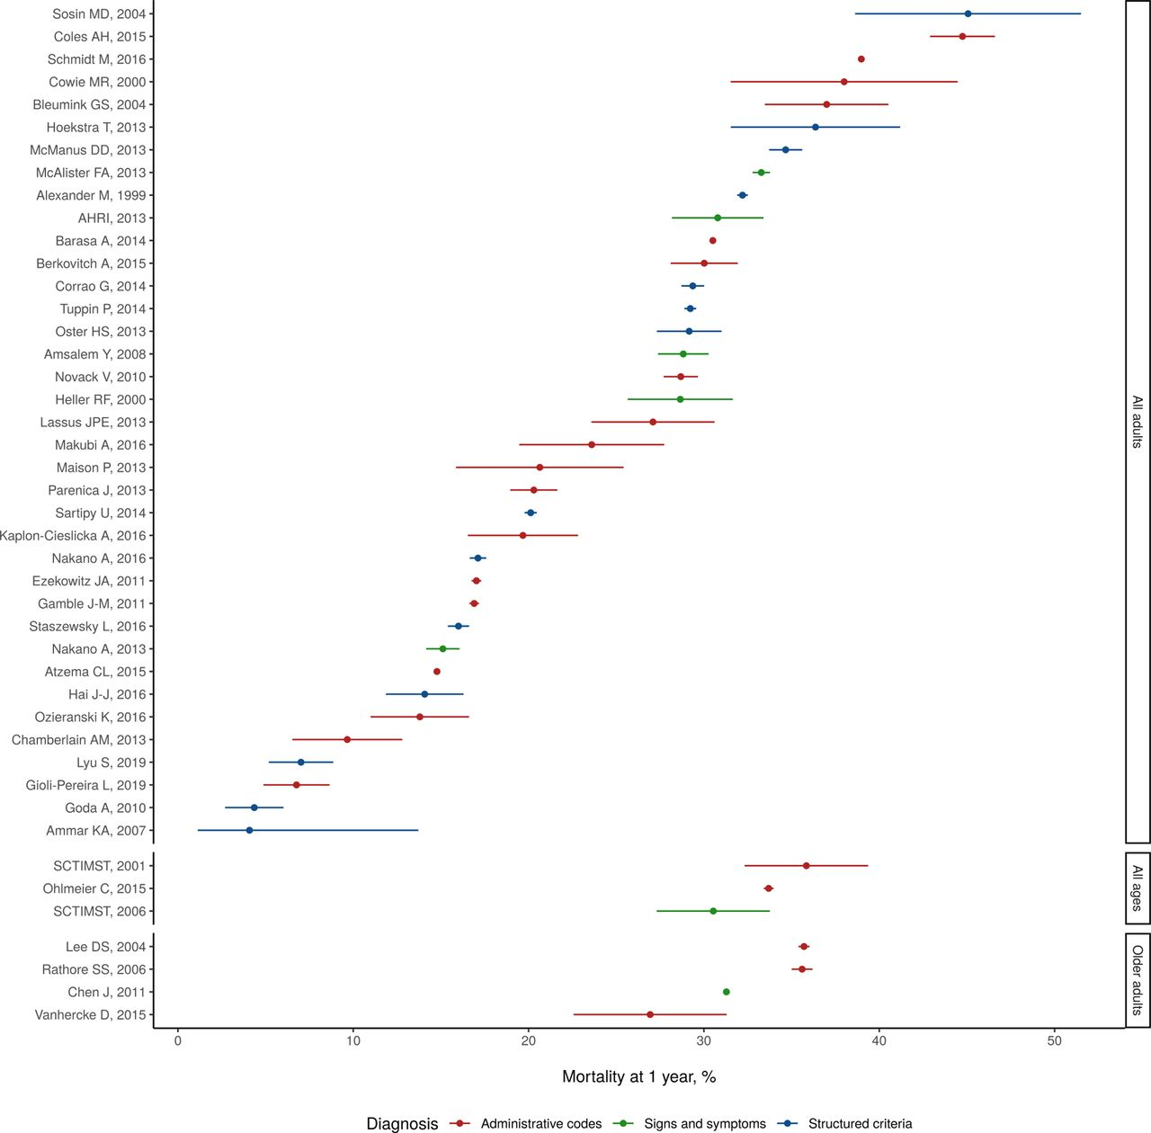
Mortality in heart failure
Emmons-Bell S, Johnson C, Roth G. Prevalence, incidence and survival of heart failure: a systematic review. Heart 2022;108:1351-1360.

Slide 32
Prognosis of heart failure
Heart failure is a chronic illness
Discuss philosophy of care with patient
Important to assess patient and family’s understanding
Identify patients that are declining and review management plan
Updating MOST forms
Involving palliative care teams

Slide 33
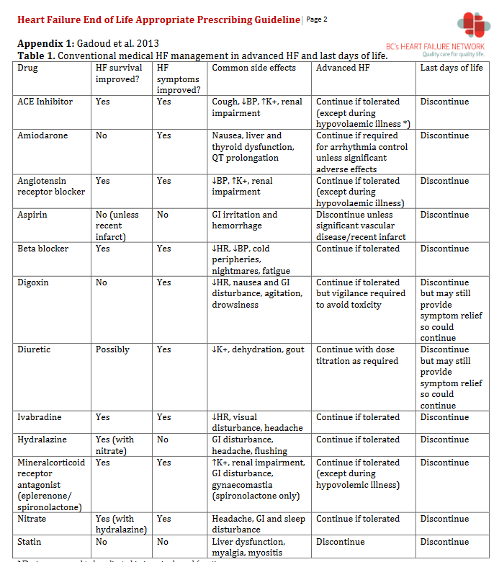

Slide 34
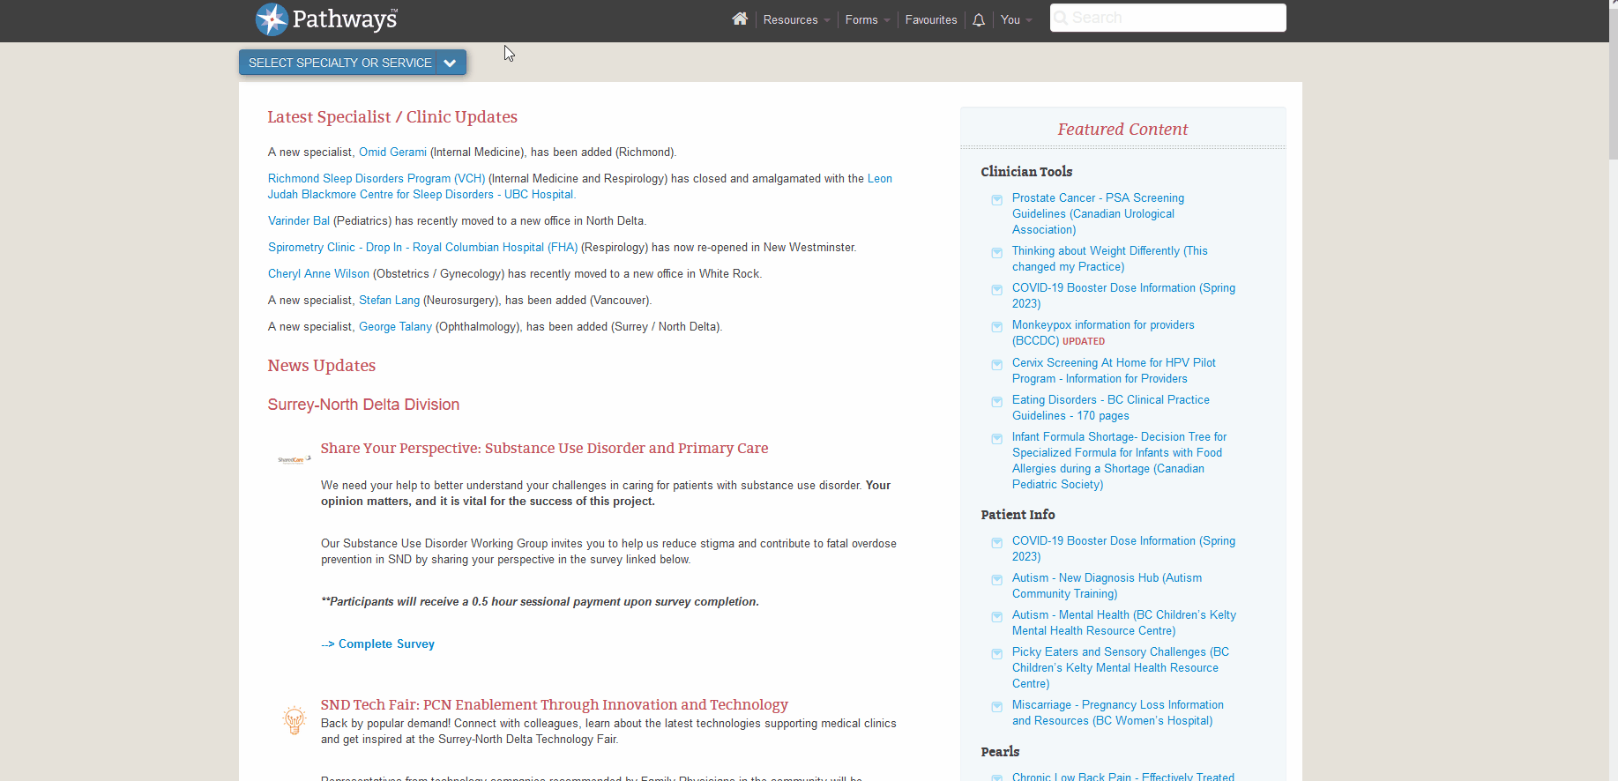
Resources

Slide 35

Palliative

Slide 36
Palliative care
Important to emphasize that patient is not being abandoned
Philosophy/goals of care are changing

Slide 37
SUMMARY
Heart failure is a common problem
Risk factors for development of heart failure are common in elderly and in South Asian patients
Important to review patient’s place in the disease trajectory to guide goals of care discussion
Transition from mortality reduction to symptom management as disease progresses
Utilize palliative care resources to help with symptom management

Slide 38
Thank you for your attention

