Slide 1
Dementias (MNCDs) ‘More Than Just Getting Old’
Dr. Vincent Choong MD FRCPC MRCPsych(UK)
Geriatric Consultation Liaison Psychiatry
Surrey Memorial Hospital
16 September 2023

Slide 2
Objectives
1. Ability to differentiate between minor vs major neurocognitive disorder
2. Identify key aspects of history, investigations for diagnosis
3. Aware of strengths and weaknesses of cognitive screening tools
4. Therapeutic options available and their limitations
5. Aware of the cultural considerations of dementia diagnosis

Slide 3
Dementia – Historical Context
Latin: demens
‘being out of one’s mind’
used since 13th century
adopted as a medical term in 18th century
treated by specialists called alienists (obsolete term for psychiatrists !)
Notes:
https://pubmed.ncbi.nlm.nih.gov/31220848/

Slide 4
Prevalence
Doubles Q5 years from 65 onwards
65-69 | 0.8%
70-74 | 2.4%
75-79 | 5.9%
80-84 | 12.4%
85+ | 24.6%
Canadian Institute for Health Information

Slide 5
Sub-types
Alzheimer’s (50-75%)
Vascular (20%)
Lewy Body/ Parkinson’s (10-15%)
Fronto-temporal (2%)
Alcohol (0.8%)
Figures vary
Mixed etiology
Clinical rather than histopathological diagnosis (gold standard)

Slide 6
Risk factors
Age
Genes (e.g. APOE₄)
Cardiovascular Disease
Low Cognitive Reserve
Ethnicity
Hearing loss
Lifestyle – smoking & EtOH
Depression
Traumatic brain injury
Notes:
https://www.alzheimers.org.uk/sites/default/files/pdf/factsheet_risk_factors_for_dementia.pdf

Slide 7
Cardiovascular Disease
Hypertension
Atherosclerosis
Dyslipidemia
Overweight and sedentary lifestyle
Type 2 diabetes.

Slide 8
Cognitive Reserves
person’s ability to cope with functional decline
bigger reserves – longer time for disease manifestation
3 most important factors leading to low cognitive reserves
Leaving education early
Less job complexity
Social isolation

Slide 9
Ethnicity
Black African, Caribbean & South Asian are at higher risk
Epigenetics – DM, Cardiac diseases, HTN, CVAs
Low cognitive reserves:
less opportunities/access to education and work
Migrant population
Lower socio-economical status

Slide 10
Clinical features
‘more than just being forgetful’
Amnesia – STM<LTM, impaired new learning
Agnosia – recognition (places & faces)
Aphasia – nominal (word finding difficulty)
Apraxia – loss of function previously acquired
Ataxia – etiological clues (hemiplegic, festinating etc)
Abulia (Apathy) – withdrawn, isolative

Slide 11
Minor vs Major Neurocognitive Disorder
Minor (MCI)
Subjective decline in cognition
Minimal impact on iADLs
Evidence of some compensatory strategies (notes, blisterpacks)
Major
Impacted iADLs
MCI has 15% annual conversion rate to MNCD

Slide 12
Function – Instrumental & Basic ADLs
Instrumental [deficits] | Basic [deficits]
(S)hopping [malnutrition] | (D)ressing [hypothermia]
(H)ousekeeping [hoarding, vermin] | (E)ating [malnutrition]
(A)ccounting [mismanagement & abuse] | (A)mbulation [falls or wandering]
(F)ood Prep (+ Meds) [fires, floodsFTT & neglect] | (T)oileting [incontinence]
(T)Ransportation [accidents & getting lost] | (H)ygiene [infection prone]

Slide 13
Clinical Diagnosis
History & Physical (70%)
Investigations (10%)
Bloodwork – Hb, vit B, calcium, glucose, TSH (reversible causes)
Neuroimaging – CT, MRI (volumetric, ischemic burden)
?VDRL – at risk groups
Cognitive testing (20%)
MMSE, MOCA & RUDAS
(Rowland’s Universal Dementia Assessment Scale)

Slide 14
Neuro-imaging
Not mandatory
But strongly recommended
<65
Rapid onset
Fluctuating nature
Multi-domain involvement
Supportive if consideration for medication trial

Slide 15
Cognitive assessment
Choose the tool wisely
Screening tool ≠ Diagnostic tool
Cognitive tools are prone to education & language biases
Inherent limitations (eg. MMSE does not test for frontal lobes)
Mild : 21-26
Moderate: 11-20
Severe : ≤ 10

Slide 16
Management
Medication
Acetylcholinesterase Inhibitor (Mild to Moderate)
Donepezil
Galantamine
Rivastigmine
NMDA Antagonist (Moderate to Severe)
Memantine (not covered by Pharmacare)

Slide 17
ACHeI Side Effects
No absolute contraindications
CNS – delirium (confusion), seizures
CVS – bradycardia
RS – broncho-constriction
GI – excessive secretions (sialorrhea, PUD, diarrhea)
MSK - cramps

Slide 18
Treatment goals
Not disease modifying (limitation of pathophysiology)
Preservation of function (iADLs)
Ultimately delaying entry into institutional care
Caveat:
what is lost cannot be regained.
You cannot acquire what has never been learnt.

Slide 19
Treatment Protocol
First review 1-3 months
Recheck MMSE
Subjective reports
If MMSE ↑ = positive responder -> continue or titrate
If MMSE ↓ = negative responder -> switch agent or D/C
Review Q6 months

Slide 20
Management
Ultimately, more than just medication
Coordinate (multi-agency) resources needed to bolster functioning
Safety / Risk assessments
Evolvement of Behavioral & Psychological Symptoms of Dementia
Depression
Psychoses
Aggression
Apathy

Slide 21
Cultural Considerations
Increased risk factors
CVD (HTN, DM, CAD)
Societal views about the elderly, aging & senility
Myths & Stigma – ‘Pagal’
Low detection at baseline (‘under the radar’)
Histories are often difficult !
‘Covert dementia’ usually picked up in acute care settings

Slide 22
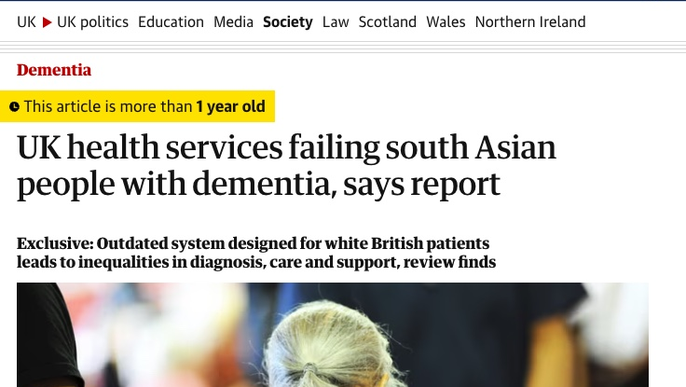
Notes:
https://www.theguardian.com/society/2022/jun/26/south-asians-with-dementia-failed-by-uk-services-report-warns

Slide 23
Resources
First Link Dementia Helpline
English: 1-800-936-6033 (Monday to Friday, 9 a.m. to 8 p.m.)
Cantonese and Mandarin: 1-833-674-5007 (Monday to Friday, 9 a.m. to 4 p.m.)
Punjabi, Hindi and Urdu: 1-833-674-5003 (Monday to Friday, 9 a.m. to 4 p.m.)
Notes:
https://alzheimer.ca/bc/en/help-support/find-support-bc/first-link-dementia-helpline

